Slide 1
Emissions Modeling Basics - Processing Emissions Inventories for Air Quality Modeling Pt. 1
Co-presented by the U.S. EPA Office of State Air Partnerships and WESTAR-WRAP
March 25, 2026

Slide 2
Outline
Foundations of and needs for Emissions Modeling​
  How does a modeling platform differ from the National Emissions Inventory (NEI)?
  What are the differences between a planning and modeling inventory?​
  What are the basics of an Emissions Modeling Platform (EMP)?
  What regulatory needs does a modeling platform meet?​
  How frequently does the EPA generate an EMP?
  Construction of an EMP
  What are the quality assurance (QA) and review procedures​ for an EMP?

Slide 3
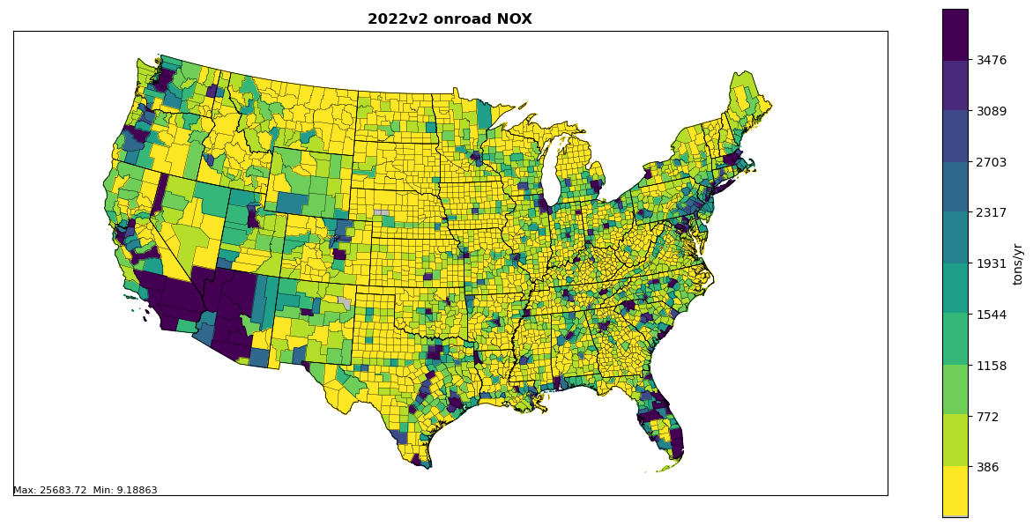
The National Emissions Inventory (NEI)​
2017
2017 NEI
2020
2020 NEI
2023
2023 NEI
The NEI is a triennial inventory that aims to:
  Be complete
  Represent the year of the inventory
  Use up-to-date science and information
  Be transparent and timely
Spatially allocated at the county-level for most sources. Point sources feature lat/lon coordinates.
The NEI inventories all emissions annually
Illustrative example of county-level emissions

Slide 4
The 2023 NEI Development Timeline
2023
Year of emissions
2024
EPA gathers data and SLTs estimate emissions
2025
EPA compiles data
2026
EPA publishes the 2023 NEI
EPA restarts process for 2026 NEI
EPA releases 2023 NEI Plan
EPA estimates emissions
EPA conducts QA/QC* of data
SLT = State, Local, and Tribal
* QA/QC = Quality assurance / quality control
The NEI classifies emissions in various ways:
  Four Data Categories
    Point, nonpoint, mobile onroad, mobile nonroad
  Over 3000 Source Classification Codes
  60 Emissions Inventory System (EIS)-Sectors

Slide 5
What is an Emissions Modeling Platform
Air Emissions Modeling
Emissions Modeling Platform
Prepares emission inventories for air quality models
Produces hourly, gridded, pollutant‑specific emissions via:
  Temporal allocation (by hour)
  Spatial allocation (to grids)
  Speciation (pollutant species)
A complete package to make model‑ready emissions:
  Inventories and other data files
  Software/tools
  Processing scripts
All data and scripts needed to prepare emissions for air quality modeling

Slide 6
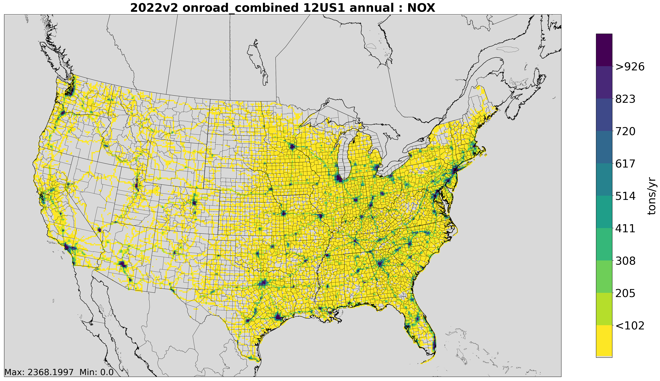
How does a modeling platform differ from the National Emissions Inventory?​
Inventory
Modeling Platform
Annual
County-level (typically)
Criteria Air Pollutants (CAPs) and their precursors
Hourly
Gridded (typically)
Speciated for photochemical modeling

Slide 7
What are the technical differences between a planning and modeling inventory?
Comparison | Planning Inventories | Modeling Inventories
Geographic Coverage | Nonattainment Area | Statewide and/or regional
Pollutant Coverage | AQ standard dependent | All CAPs + precursors
Sectoral Coverage | Anthropogenic Emissions | Anthropogenic + Natural Emissions
Temporal Coverage | Usually annual or ozone season | Start off as annual, transformed into hourly

Slide 8
What are the policy-relevant differences between a Planning and Modeling Inventory?
  Planning Inventory
  Supports regulatory planning, State Implementation Plan (SIP) development
  Used for attainment baseline emissions, projected inventories to show reasonable further progress demonstrations, control strategy development, transportation conformity
  Modeling Inventory
  Serve as input into photochemical models (e.g., CMAQ, CAMx)
  Used for attainment demonstrations, Regional Haze and transport modeling, policy scenario analysis
CMAQ = Community Multi-scale Air Quality Model
CAMx = Comprehensive Air Quality Model with Extensions

Slide 9
Major components of a modeling platform
  Emissions
  Base year and possibly future (“analytic”) year projections, depending on needs.
  International emissions for hemispheric modeling to generate boundary conditions.
  Meteorological Data
  Meteorological data is a key input into a photochemical model. User may need to generate their own meteorological data if their domain of interest is different than the standard EPA domain.
  Other Ancillary Data
  Data needed for emissions modeling and associated tools (e.g., SMOKE).
SMOKE = Sparse Matrix Operator Kernel Emissions

Slide 10
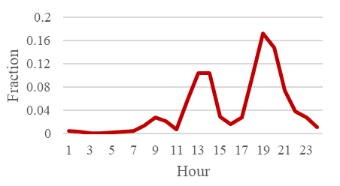
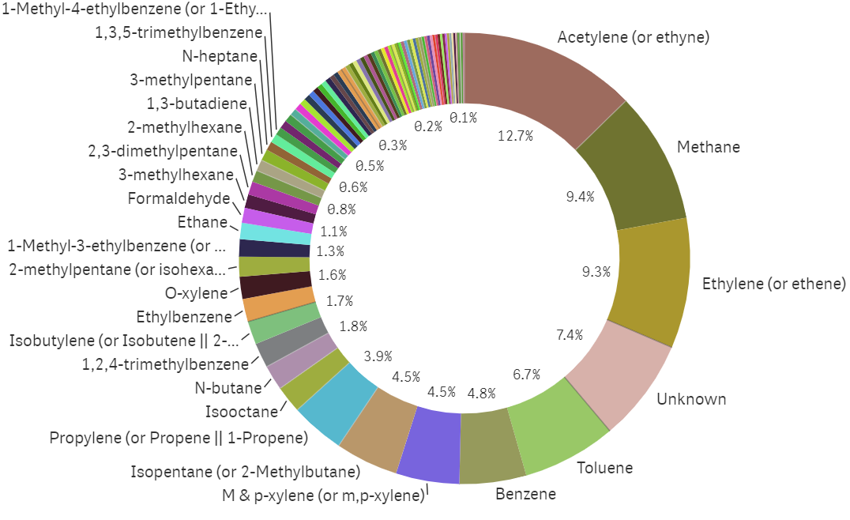
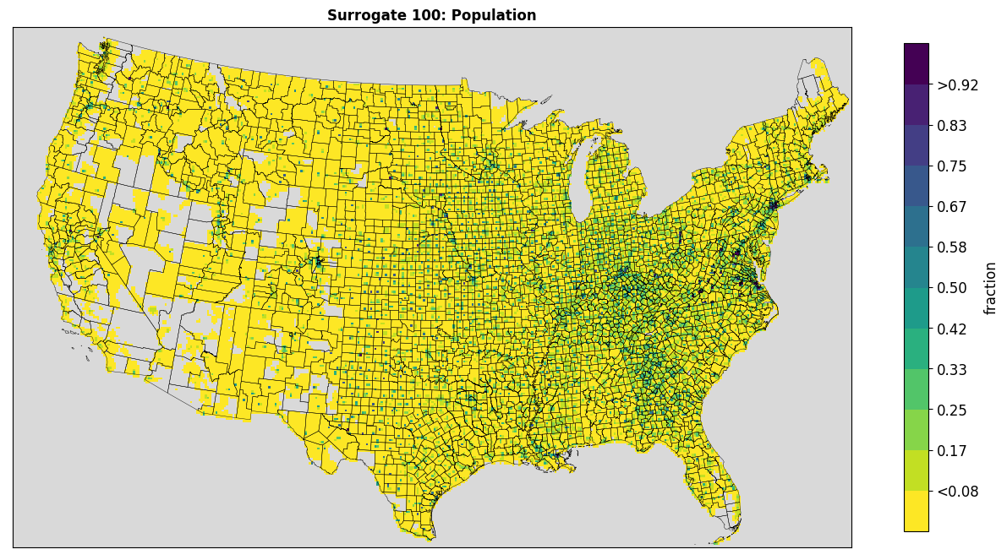
Simplified Emissions Modeling Process
Note that these processes can (and sometimes do) get assigned at the county and source classification code level!
Temporalized
Speciated
Annual, aggregated, and bulk components (e.g., VOC)
Spatialized
Hourly, gridded, and speciated for photochemical modeling

Slide 11
What regulatory needs does a modeling platform meet?​
Demonstration of the NAAQS
Control Strategy Evaluation
Interstate Transport Analyses
Regional Haze Planning
States must show NAAs will reach compliance with the ozone and PM NAAQS. An EMP provides the future-year emissions inputs needed to model whether the area will attain the standards.
Modeling platforms support regulatory analysis of control measures by allowing agencies to test scenarios (e.g., sector-specific reductions, fuel changes, emissions controls, mobile source standards).
Analyze the extent to which upwind states contribute to nonattainment in downwind locations and how emissions reductions affect regional air quality.
Historically has been used to evaluate source contributions to visibility impairment in Class I areas as well as quantifying impacts from international sources to adjust estimates of natural conditions.
NAA = non-attainment areas
PM = particulate matter
Notes:
Important for Ozone, PM2.5, PM10
Supports SIP control strategies, rulemankings, cost-benefit analyses
The latest example of a regulatory transport analysis is the GNP addressing interstate ozone transport for the 2015 O3 NAAQS.
Not listed on slide: national rulemaking and characterizing background (ozone) and transport (international, smoke)

Slide 12
How frequently does the EPA generate an EMP?
2016
Modeling Platforms: 2016fh, 2016fj, 2016gf
2017
2017 NEI
2018
Modeling Platforms: 2018gc, 2018gg
2019
2020
2021
2022
2023
2020 NEI
2023 NEI
Modeling Platform: 2017gb
Modeling Platform: 2019ge
Modeling Platforms: 2020ha2
Modeling Platform: 2021hb
Modeling Platforms: 2022hc, 2022hd, 2022he
EPA generates a NEI every three years.
Since 2016, EPA has generated a modeling platform for each calendar year.
  Nomenclature for platform names is discussed on next slide.

Slide 13
EPA’s Emissions Modeling Case Abbreviations
EPA’s 2022v2 Emissions Modeling Platform:
2022he_cb6_22m
EPA’s meteorological case name (i.e., 22 = 2022)
The year represented in the modeling
A letter representing the NEI base year:
2014 NEI
2017 NEI
2020 NEI
A letter representing the iteration of the emissions:
1st iteration
2nd iteration
Optional: Speciation used (e.g., CB6 chemical mechanism)

Slide 14
Constructing an EMP
The methods used to construct an EMP depend on the need or intended use of the data.
  Many platforms have been developed by EPA with help from contractors.
  Start with the most recent NEI: project emission year forward or backwards, keep emissions constant with NEI year, or generate new year-specific emissions estimates using emissions tools or models.
  Generally, for EPA modeling platforms, fires, mobile sources, large stationary sources, and some nonpoint sectors are year-specific.
EPA often solicits and/or coordinates with stakeholders to contribute to the platform development effort.

Slide 15
The National Emissions Collaborative (NEC)
  The NEC is a partnership between state inventory staff, multi-jurisdictional organizations, federal land managers, EPA, and others to develop an EMP for use in air quality planning.
  The collaborative enables stakeholders to participate more in the construction of an inventory that will be used for air quality planning.
  Building a platform is resource intensive → working together lessens the burden.
The 2022 Emissions Modeling Platform
  The NEC most recently helped construct the 2022 base year inventory, analytic year inventories, ancillary emissions data, and documentation.
  All participants reviewed and refined inventory results and assumptions.

Slide 16
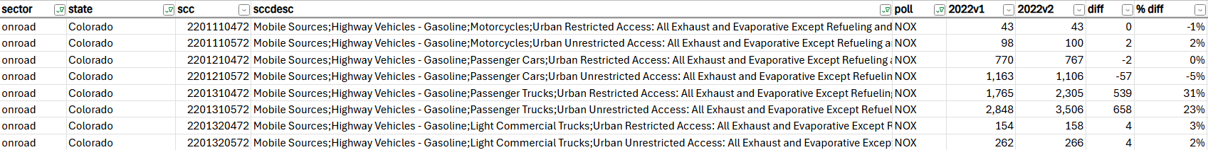
What are the QA and review procedures​ for an EMP?
Examples of QA assessments include
  Comparison of an older inventory to the new inventory
Why did the estimates change and do they make sense?
  In this case, MOVES4 → MOVES5; yes!
MOVES = MOtor Vehicle Emission Simulator

Slide 17
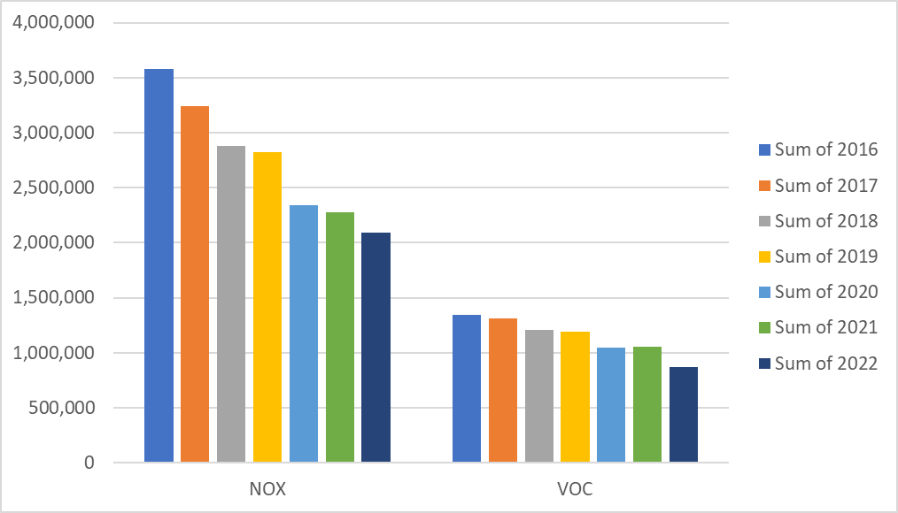
What are the QA and review procedures​ for an EMP?
Examples of QA assessments include comparison of trends over time
Decline in onroad mobile emissions over time due to turnover of vehicle fleet
Notable drop in 2020 related to COVID

Slide 18
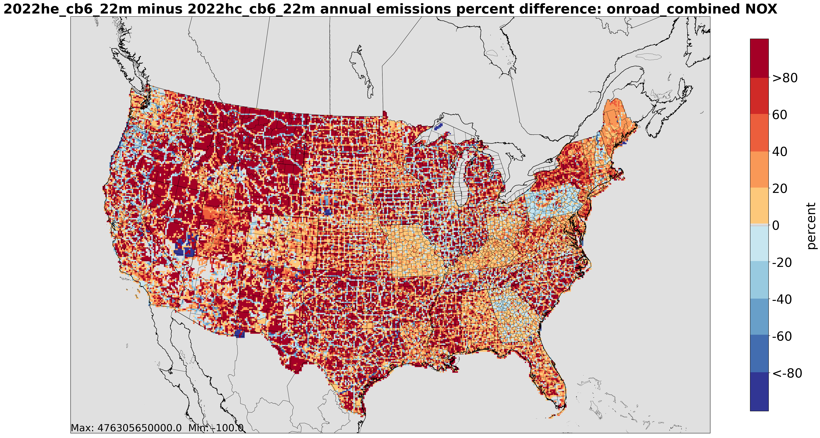
What are the QA and review procedures​ for an EMP?
Examples of QA assessments include comparison of spatial plots
Onroad mobile NOX
Percent difference plot between 2022v1 and 2022v2
The update from MOVES4 to MOVES5 resulted in near universal increases in onroad nitrogen oxides (NOx)

Slide 19
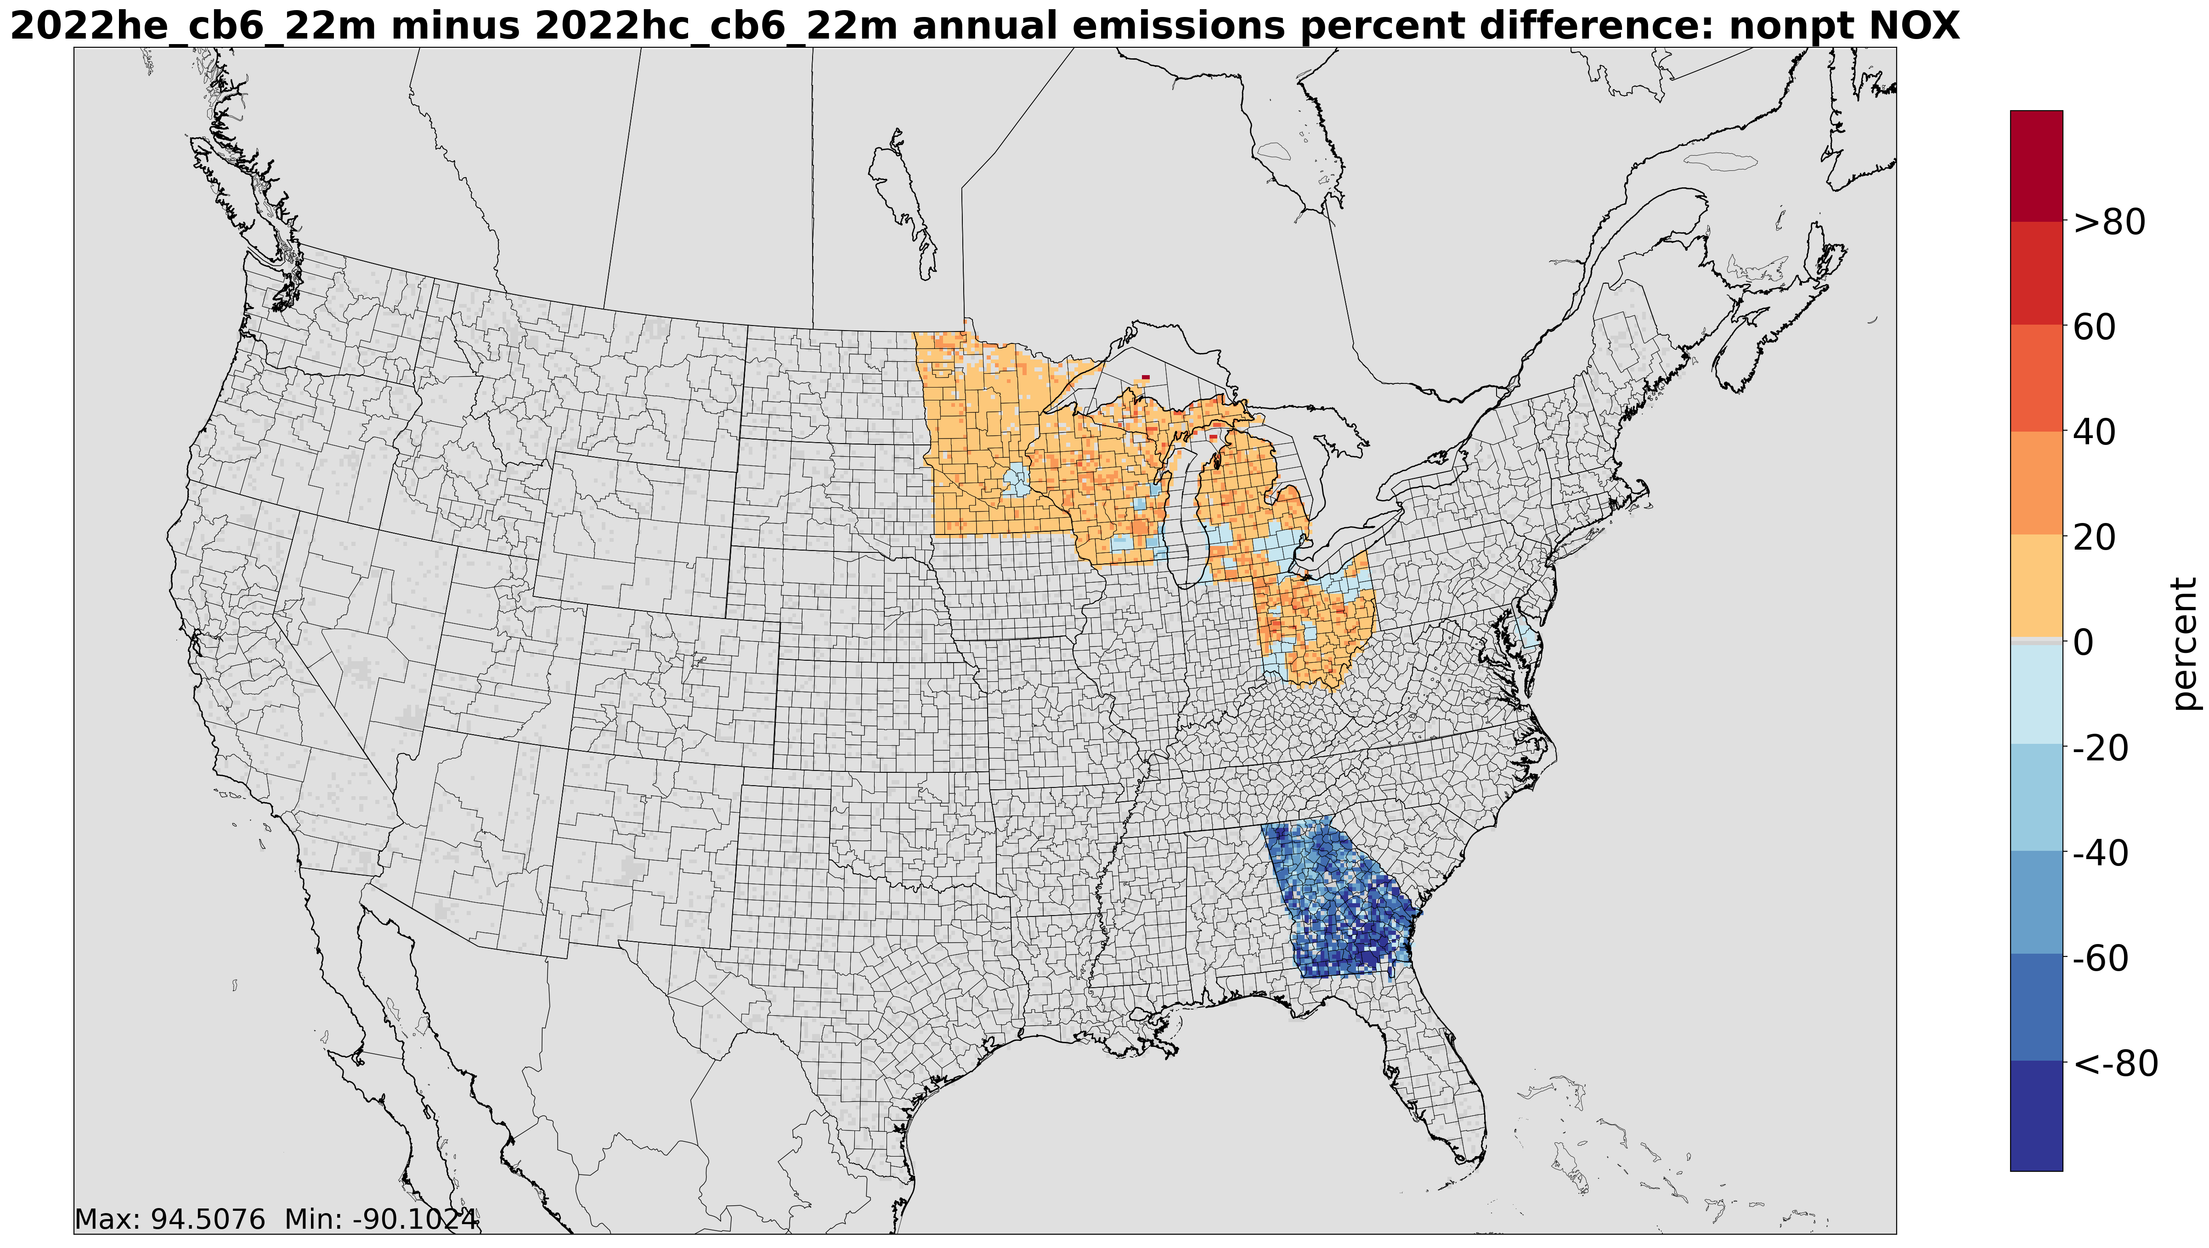
What are the QA and review procedures​ for an EMP?
Examples of QA assessments include comparison of spatial plots
Nonpt NOx
Percent difference plot between 2022v1 and 2022v2
In the “nonpt” sector, consisting of all residual nonpoint sources, most states did not feature any changes
Based on SLT review, comments and/or updates were included for the select few who did participate in the NEC effort

Slide 20
Questions?

