Slide 1
Understanding Modern Heat Pumps
A New Frontier!

Slide 2
We’ve come a long way!

Slide 3
Old vs New

Slide 4
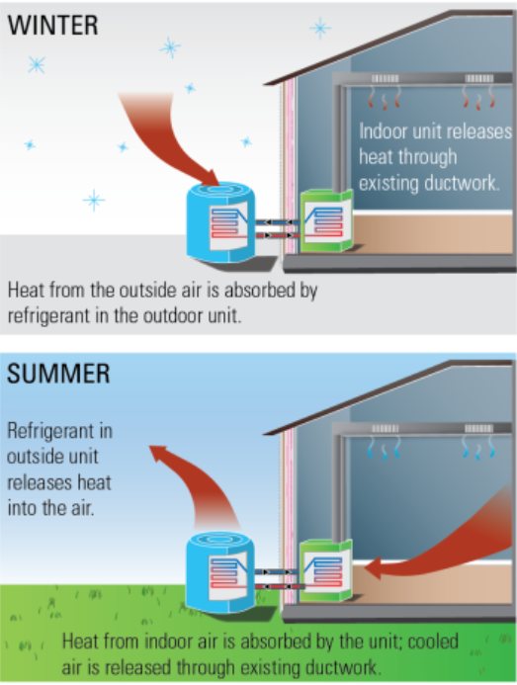
Types of ASHPs

Slide 5
Components of a Heat Pump
Notes:
Components
Outdoor Unit
Indoor Unit
Refrigerant Lines
Controls

Slide 6
Acronyms, Acronyms, Acronyms
Heating Efficiency
Heating season performance factor (HSPF): ratio of the total space heating provided to the total electrical energy consumed by the heat pump during a heating season
Coefficient of Performance (COP): similar to HSPF but uses different units and can be measured over shorter time periods. It is also the ratio of heat delivered to the electrical energy required
Cooling Efficiency
Energy Efficiency Ratio (EER): ratio of the heat removed to the electrical power used to remove the heat
Seasonal Energy Efficiency Ratio (SEER): ratio of the heat removed during the cooling season to the total electrical energy used

Slide 7
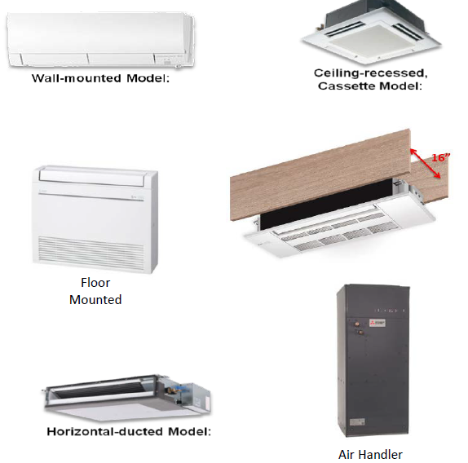
Solutions for Multiple Applications
Traditional ducted systems can replace Central AC units
Existing heating system can be used as back-up
Mini-split systems offer flexible solutions
Can be wall or floor mounted, recessed in ceiling
Single or multi-zone

Slide 8
Cold Climate Advancements
Cold-Weather Refrigerants: Cold climate heat pumps use refrigerants that have a lower boiling point than traditional heat pump refrigerants. These refrigerants can continue flowing through a system at low ambient temperatures and draw more heat energy from cold air.
Compressor Design: Variable-speed compressors can run at a low percentage of their maximum speed in moderate weather, then switch to higher speeds at extreme temperatures. Instead of using an all-or-nothing approach, these inverters draw the right amount of energy to keep indoors spaces at a comfortable temperature.
Variable speed fans: variable-speed controls for these fans attempt to keep the air moving at a comfortable velocity, minimizing cool drafts and maximizing electrical savings
RESULT? Air-source heat pumps that can heat a home in the coldest climates!

Slide 9
Contractor Considerations
Step 1. Evaluating your existing home efficiency. Low levels of insulation and air leaks means your system works harder and can lead to energy waste.
Step 2. Determining the sizing and location of the system components. The size of your system is a crucial determining factor of effective heating, cooling, and dehumidifying of your space. Remember, bigger is not always better!
Step 3. Ensuring proper system insulation and airflow. Each component of your ASHP contributes to your system’s proper functioning. Minimizing the occurrence of leaks or damage will help your ASHP system run at peak efficiency and increase the longevity of your unit. Air flow is important for enjoying your ASHP system’s heating and cooling benefits.
Step 4. Operating and maintaining your new ASHP system. Ask your contractor to walk you through how to operate your new ASHP to achieve the optimal efficiency and comfort benefits, such as how to use the thermostat to set the temperature and adjusting the fan settings.

Slide 10
How to Identify Cold Climate Heat Pumps
Look for the ENERGY STAR label!

Slide 11
ENERGY STAR® Central Air Conditioners & Heat Pumps
A New Vision

Slide 12
ENERGY STAR Certification Designates High Efficiency for:
More than 75 product categories
Multifamily, manufactured and single-family homes
21 commercial building property types
Industrial plants in 31 diverse sectors
To earn the label, EPA requires third-party certifications in all categories
5.8 BILLION
products
35,000
buildings
190
industrial plants
1.9 MILLION
homes
Notes:
For those that may not be aware, and hopefully there aren’t many of you, ENERGY STAR is the government backed symbol for energy efficiency. The label is used to identify highly efficient products, homes, and buildings and we strive to provide simple, credible, unbiased information that consumers and businesses can use to make better choices.
For the past couple of decades, ENERGY STAR has developed and implemented awareness campaigns to educate consumers on the benefits of efficient products. Some of you may be familiar with the Change A Light, Change the World campaign, Flip Your Fridge, the Rule Your Attic campaign, and others. These efforts have been very successful. And one of the reasons they are so successful…

Slide 13
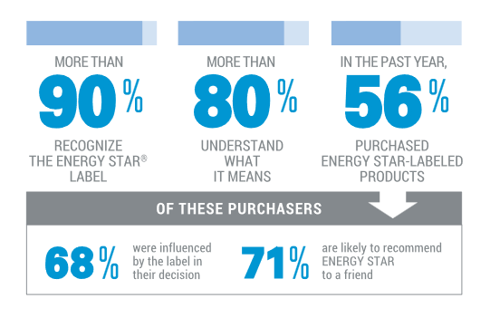
Awareness of ENERGY STAR
National Awareness of ENERGY STAR for 2019: Analysis of Consortium For Energy Efficiency (CEE) Survey
National Awareness of ENERGY STAR for 2019: Analysis of Consortium For Energy Efficiency (CEE) Survey

Slide 14
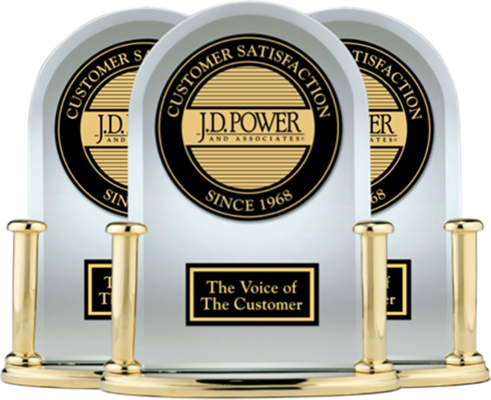
Value of ENERGY STAR
A 2017 study found JD Power Customer Satisfaction indexes for ENERGY STAR partners increased significantly over time compared to non-partners, particularly in the areas of Corporate Citizenship, Communications, and Customer Service.
A/B testing conducted by Focus on Energy shows that using the ENERGY STAR logo on ads drove a 60% increase in click- through rate.
+
=
21

Slide 15
ENERGY STAR Specification Development
Notes:
ENERGY STAR Guiding Principles ✓ Significant energy savings on a national basis ✓ Product performance maintained or enhanced with increased efficiency ✓ Consumers recover investment in efficiency within a reasonable period of time ✓ Efficiency can be achieved with one or more technologies from manufacturers ✓ Energy consumption and performance can be measured and verified with testing

Slide 16
Integrity Efforts for ENERGY STAR Products
Product-Specific Requirements are the foundation for ENERGY STAR product labeling, defining performance eligibility based on objective, repeatable test procedures. Updates to specifications allow ENERGY STAR to deliver on its promise to designate products and services that protect the environment through superior energy efficiency without trade-offs in performance or functionality
Third-party certification. To ensure consumer confidence in the ENERGY STAR label and to protect the investment of ENERGY STAR partners, The U.S. Environmental Protection Agency (EPA) requires all ENERGY STAR products to be third-party certified. Products are tested in an EPA-recognized laboratory and reviewed by an EPA-recognized certification body before they can carry the label
“Off-the-shelf” Verification Testing. EPA oversees verification testing to ensure products associated with the ENERGY STAR label continue to comply with program requirements. In 2021, approximately 2000 product models were tested; 96 percent complied, affirming consumer confidence in the label.

Slide 17
Why Revise?
Time: Version 5.0 effective 2015
Increased interest in electrification & cold climate optimized heat pumps
Developing consensus around grid services for CAC/ASHP
Estimated Market Share of ENERGY STAR Certified CAC/HPs
 | 2018 | 2019
Overall | 33% | 41%
CACs | 28% | 30%
ASHPs | 43% | 59%
2018 ENERGY STAR Unit Shipment and Market Penetration Report
2019 ENERGY STAR Unit Shipment and Market Penetration Report
Notes:
23% of total AHRI list meets or exceeds 16 SEER, implying dual or variable capacity
Market share for V5.0 has been consistently around 28-29% since 2015 (2015 – 29%, 2016 – 28%, 2017 – 28%)

Slide 18
New Initiatives Reflected in V6.0 Specification
Climate differentiated AHSP criteria and marks help consumers and contractors easily identify units optimized for cold climates
Installation capabilities help ensure that excellent equipment will be installed well
Optional connected criteria focus on harnessing the potential of staged and variable capacity units to balance grid needs and consumer comfort

Slide 19
Air Source Heat Pumps: Different Climates, Different Needs
Cold Climate
Excellent seasonal heating performance
Maintains performance at low ambient temperatures
No geographic limit – programs, contractors, purchasers decide what each home needs
Excludes gas/electric package heat pumps, which are not eligible for the Cold Climate designation.
Base ENERGY STAR
Levels raised to account for 2023 standards, set in new metrics

Slide 20
Central Air Conditioner and Heat Pump – Revised Criteria (v. 6.1)
Product Type | SEER2 | EER2 | HSPF2
CAC Split System | ≥ 15.2 | ≥ 12.0
CAC Single Package Equipment |  | ≥ 11.5
HP Split System |  | ≥ 11.7 | ≥ 7.8
HP Single Package System |  | ≥ 10.6 | ≥ 7.2
Cold Climate HP Criteria
HP Split System (Non-Ducted) | ≥15.2 |  | ≥ 8.5
HP Split System (Ducted) |  |  | ≥ 8.1
HP Single Package Equipment |  |  | ≥ 8.1
Effective Jan. 1, 2023
Separate criteria for designating heat pump criteria in cold climates
Optional recognition for
Installation capabilities
Connectivity

Slide 21
HP Criteria – Cold Climate Low ambient performance
COP @ 5 °F: Harmonized with NEEP ccASHP Specification
Percentage of Heating Capacity: Minimize use of electric resistance backup
Also must demonstrate COP and heating capacity achieved under native controls using a new Controls Verification Procedure (CVP) by effective date
EPA may add additional methods to demonstrate low ambient performance in the future
.
Product Type | 2023 Test Method |  | Current Test Method
 | COP @ 5°F | Percentage of Heating Capacity @ 5°F | COP @ 5°F | Percentage of Heating Capacity @ 5°F
HP Split Systems | 1.75 | 70% | 1.75 | 70%
HP Single Package Equipment | 1.75 | 70% | 1.75 | 70%
Notes:
COP @ 5 degrees and percentage of heating capacity to ensure performance and consumer experience, want to ensure that consumers see the value and also feel that the technology is adequately meeting their comfort needs. Ensuring performance will lead to higher trust in Estar label
Lowered heating capacity from 80% to 70%

Slide 22
Installation Capabilities and Connected
Installation Capabilities:
Measures in the CAC/HP Version 6 specification advance this work
Criteria is optional, but products that meet criteria will be highlighted on the ENERGY STAR website. Centrally ducted CAC/HPs need to provide at least three and mini-splits and multi-splits at least two of the capabilities.
Coordinated with recent ACCA/RESNET Standard 310: HVAC Installation Grading
Connected criteria standardize for a future of flexible loads
Cooling (and increasingly heating) drive peak electricity demand
Standardizing messages and responses make setting up grid responsiveness easier, deliver more value
Criteria for CAC/HP based on AHRI 1380
Notes:
Immediate Feedback Facilitates Good Installations
Predicted energy savings realized
Consumers remain confident in high efficiency units
Products must provide three of six specified capabilities
Sources:
ESME system status and messaging criteria
ACCA/RESNET Standard 310
Modified by conversation with stakeholders

Slide 23
How this specification relates to others
Very similar to NEEP ccHP specification
Adds testing for low ambient performance, including under units’ native or recommended control
Adds requirements of max heating capacity at 5F at least 70% of nominal 47F heating capacity
CEE Tiers uses 17F performance
In active discussion of alignment
DOE cold climate heat pump technology challenge
A higher tier of performance, representing the next step

Slide 24
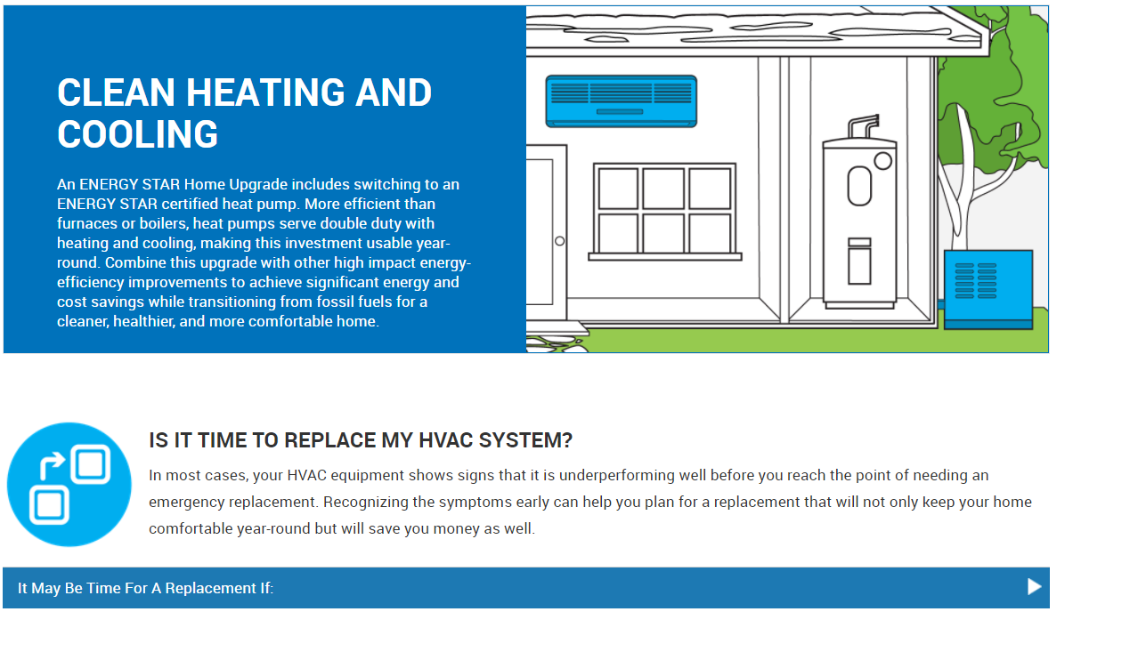
Marketing Efforts Address Barriers
Marketing efforts overcome barriers to generate consumer demand and adoption of ENERGY STAR certified ASHP systems
Complexity and Cost Barrier
Developed guidance to give consumers access information they need:
Information on equipment replacement
Purchase and installation guidance
Available Rebates
Replacement savings calculator

Slide 25
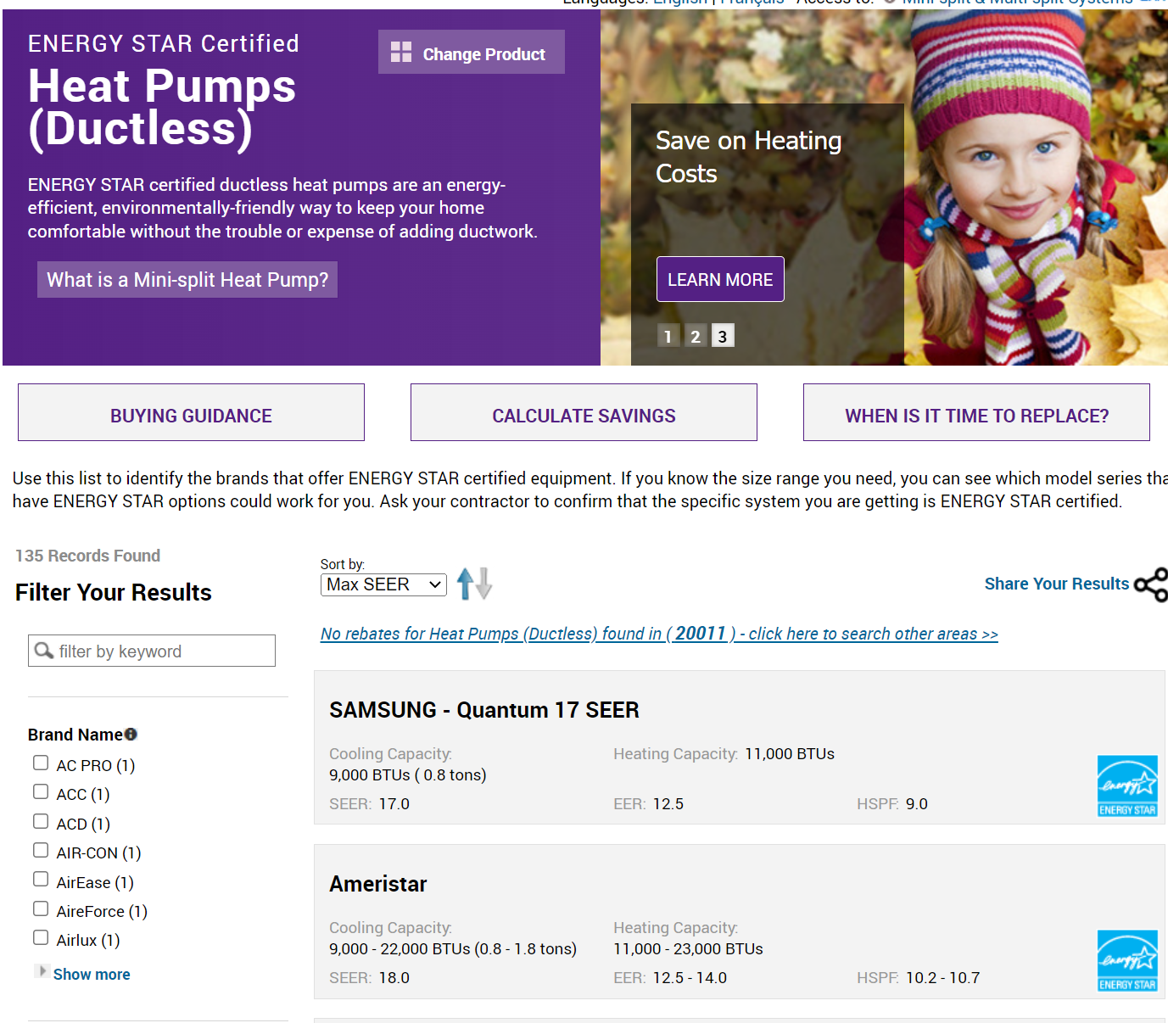
ENERGY STAR Qualified Product Lists
Developed a Product Finder that connects customers to brands and ENERGY STAR certified product lines that facilitate contractor support.
Lists are sortable by capacity, efficiency levels, and additional features, such as Cold Climate and tax credit eligibility
Ducted QPL available here: https://www.energystar.gov/productfinder/product/certified-central-heat-pumps/results
Mini-Split QPL available here: https://www.energystar.gov/productfinder/product/certified-mini-split-heat-pumps/results

Slide 26
Questions?
Abigail Daken
Daken.Abigail@epa.gov
202-343-9375
Dan Lawlor
Lawlor.Daniel@epa.gov
202-564-8561

