Slide 1
residential wood heaters
Nick Czarnecki
ANPMS Program Manager
Alaska Department of Environmental Conservation
Lisa Rector
Policy and Program Director
NESCAUM

Slide 2
Why focus on test methods?
Test Methods are difficult
Complex
Detail-oriented
Arcane
Understanding what the tests measure and what the values mean is a critical underpinning to identifying top-performing technologies.
If the test is not valid or representative, what value is the data?

Slide 3
issues existing test methods
Do not reflect typical use and fueling patterns
Operational protocols are steady-state, but data shows that in-home use is highly variable
Use the same loading configuration for every test
Burning fuel loads to 100%
Allows the manufacturer broad and the lab broad discretion in how the certification testing is conducted.
Test methods do not accurately recognize differences
Thermostatically controlled appliances are operated differently than manually fed appliances
Indoor units versus outdoor
Mal-adaptations in testing at certification labs
Vaguely written methods allow broad interpretation
NO replicate runs so no assessment of performance variability
Methods allow test until you pass
Methods allow manufacturer instructions to direct critical elements in testing.

Slide 4
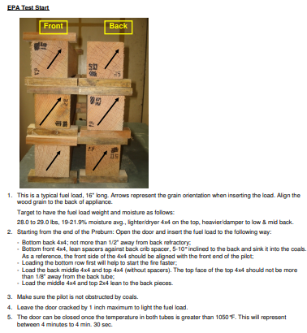
Example M28 instructions

Slide 5
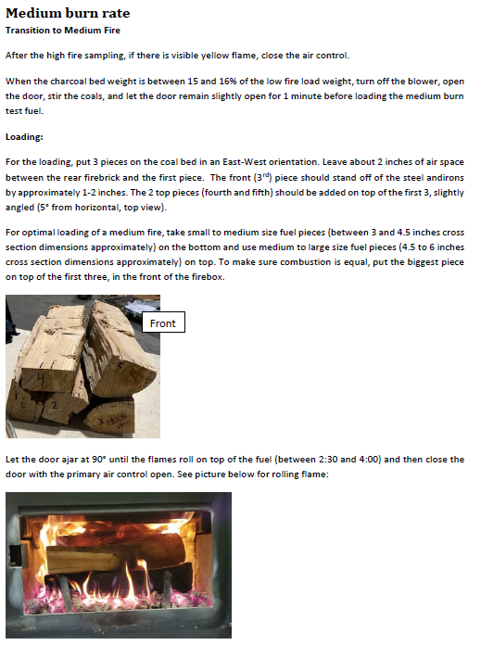
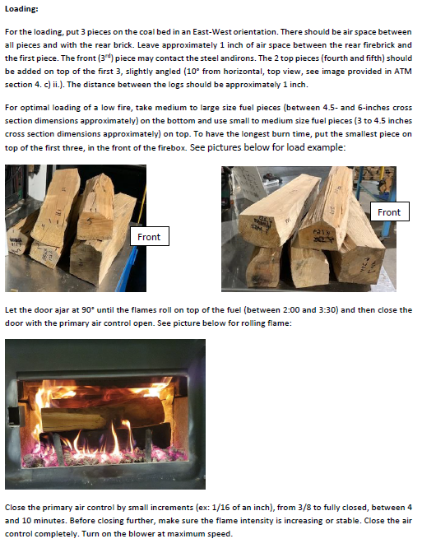

Slide 7
ASTM 3053-based Testing: Impact of Changing Fueling Instructions
*Data from Stove 9 provided to EPA for ADEC ATM Revocation Request

Slide 8
Development of IDC Protocols
Built on the philosophy of European Test Method Effort (BeReal) BUT applied to reflect US market conditions.
Reflect common operational practices
For cordwood appliances, introduce variability into fuel loads
Added replicate testing
Adopts new measurement approaches
TEOM/pDR
Moves away from ASTM methods and returns to use of EPA Methods
Creates variable loading conditions for cordwood appliances to assess how an appliance responds when loads change spacing and piece size.
Developed in partnership with many stakeholders – 2 yrs of stakeholder meetings
Industry consultants
Manufacturers
National experts on PM measurement
National Lab (Brookhaven National Lab)
Regulators (local, state, federal)
State energy organization
Testing labs

Slide 9
IDC Cordwood Fueling Protocols
Fuel calculator that determines the target number of fuel pieces and fuel weights based on total firebox size
Defines single log length
Requires three different fueling configurations
7 lb/ft³ with small pieces
5 lb/ft³ with large pieces
12 lb/ft³ with mixed pieces
Does not allow manufacturer or lab to use set spacing between fuels

Slide 10
WHY we think IDC provides better indicator of field performance

Slide 11
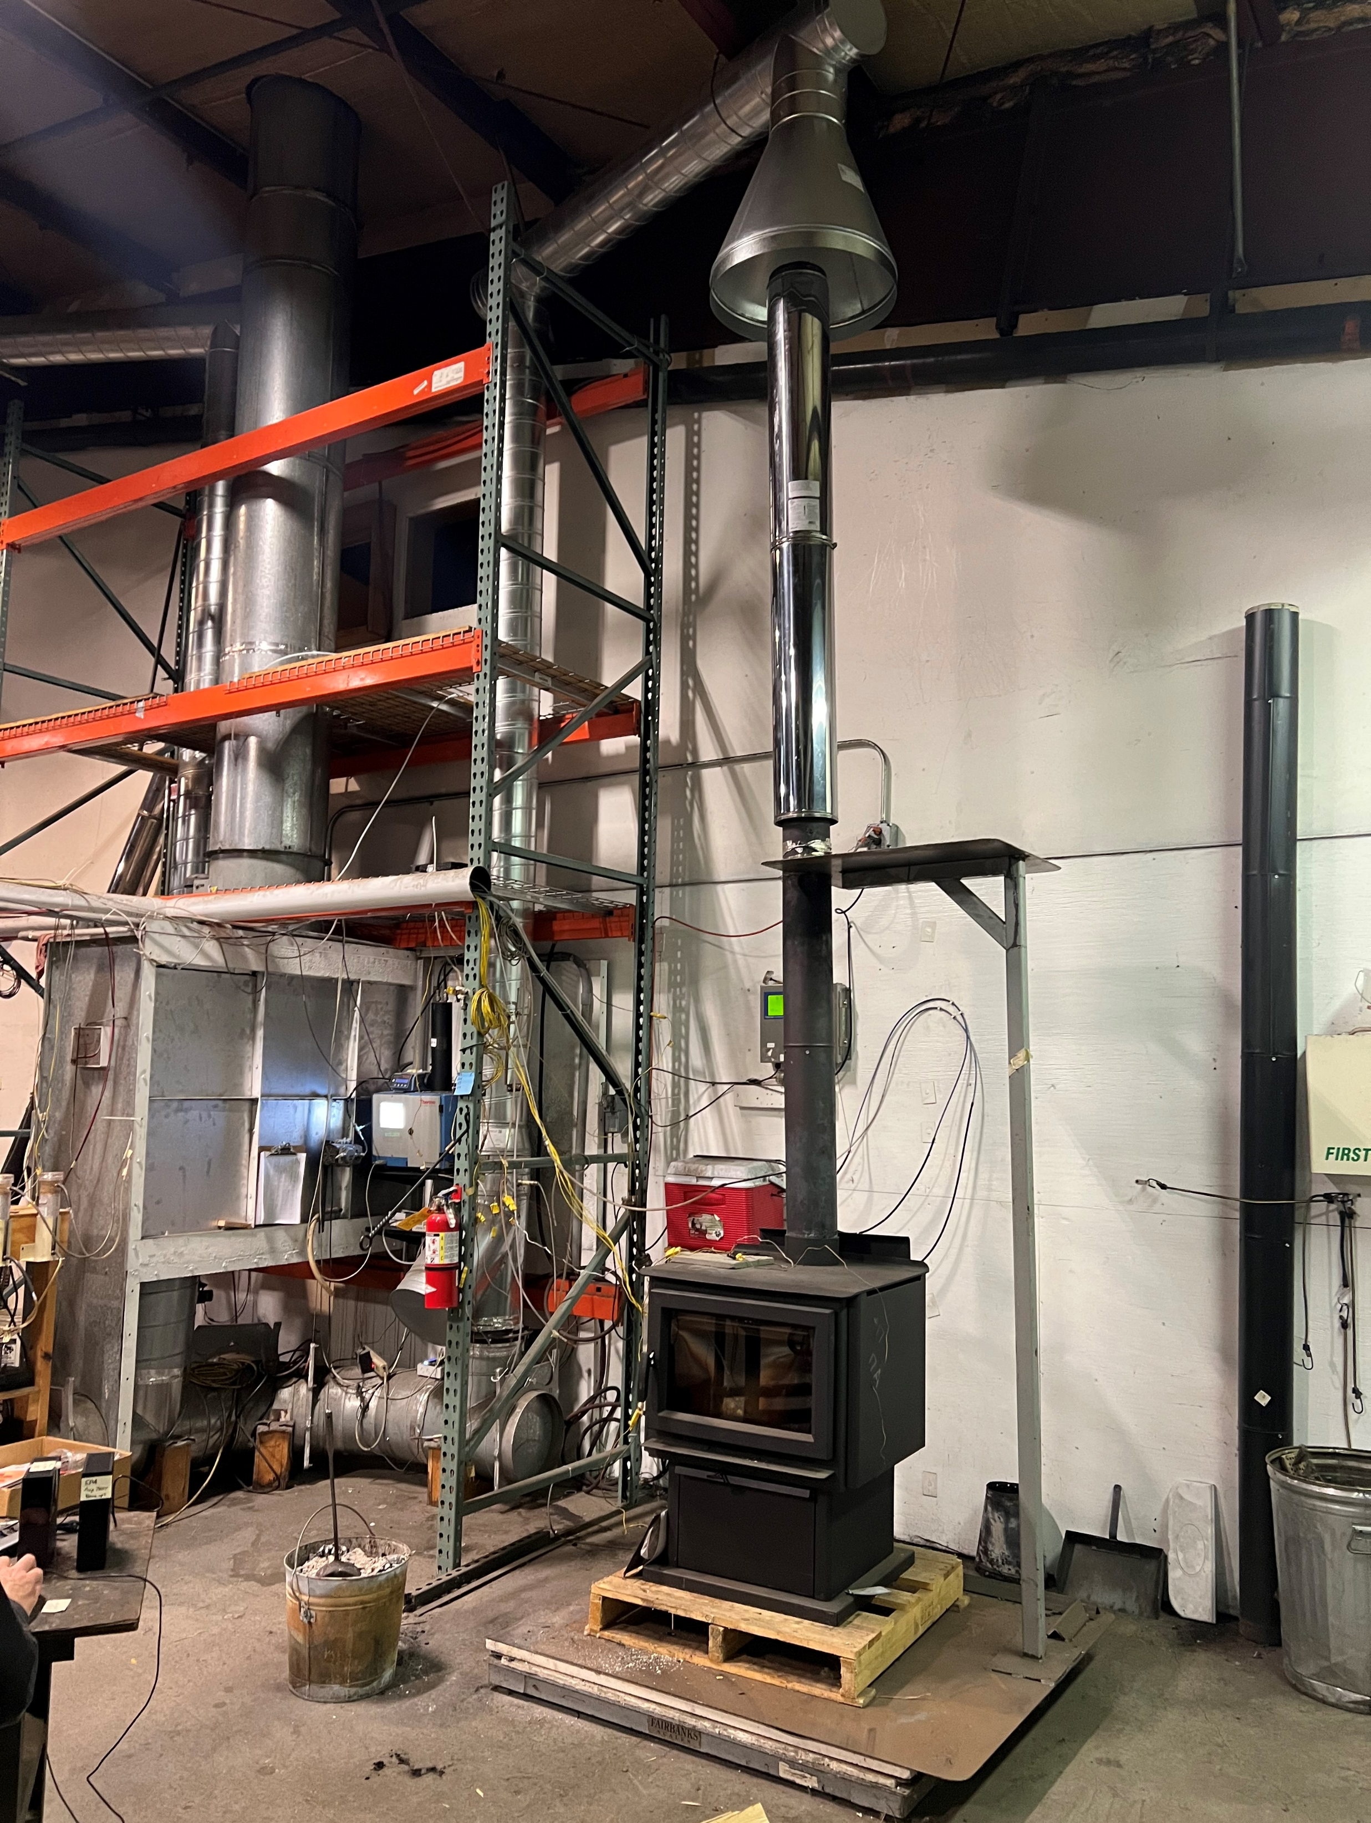
EPA EAST Coast Testing
EPA drafted a research plan to assess the precision and variability of IDC test methods
EPA IDC Variability and Precision Assessment.
EPA funding west coast lab and ORD work
NYSERDA funding NESCAUM to support east coast work happening in CT and VT
Cordwood stoves work in process on east coast completed late Spring 2023
Pellet Boilers completed on the east coast
Cordwood boilers east coast start May 2023 complete by August 23.
Pellet stove work on east coast completed by September 2023.
Furnaces: TBD
NYSERDA supported testing at the East Coast lab, completed testing on cordwood boilers, and is completing cordwood stove testing.

Slide 12
Air Toxics Testing
Lab testing of stoves with IDC method burning maple and birch (seasoned):
Uncertified cordwood stove – Pre-NSPS
Two Step 2 NC cordwood stoves
Measurements
Criteria pollutants - total PM, CO, NOx, VOC, lead – no SO2
Air Toxics - – speciated VOCs, formaldehyde, speciated PAH, speciated metals, benzene
GHG – CO2, benzene, black carbon, methane
Initial findings
Lead, formaldehyde, THC, NMTHC emissions are higher than predicted
New emission factors for air toxics and GHGs that don’t have AP-42 data
Two Step 2 Cat/Hybrid stoves
Step 2 pellet stove – softwood and hardwood pellets

Slide 13
IG Report Findings
Regulators and the public cannot rely on EPA’s RWH program
Taxpayer dollars wasting money on change-outs that may not substantially reduce emissions
Concerns about allowing continued sale of appliances using ASTM 3053-based test methods

Slide 14
Outcomes from EPA’s IG Report
Many want to keep wood fuel as a heating option but will face obstacles if test methods don’t identify cleanest technologies.
Current monitoring studies suggest that change-outs may not improve air quality. Multiple studies have found no air quality improvement, and in some cases, increases in ambient PM levels.
Review found that certified appliances:
Do not follow rule or test method requirements
ISO certified 3rd Party Reviewers Issue certificates of conformity for reports that do meet rule
Impacts for taxpayer subsidized change-out programs

Slide 15
EPA certification Emissions – ASTM 3053-based not repeatable or reliable
All appliances tested exceeded the allowable range for compliance audits. Values would trigger mandatory suspension of sales under NSPS.
Emissions results 3.6 to 17.4 times higher when comparing certification values to replicate certification test.
Emissions results 2.4 to 27.7 times higher when comparing certification test values to test values using owner’s manual instructions.
Estimated Certification Expiration Date
Jotul 4/2024
SBI 3/2027
Wolf Steel 7/2024
US Stove 7/2024
England Stove 5/2025
Travis Industries 11/2023
GHB Group 8/2025
2.5 cert value

Slide 16
epa certification Efficiency – ASTM 3053-based not repeatable or reliable
Efficiency
values are used for BTU credits
Some change-outs use efficiency for list inclusion or additional benefit
Two units in study qualified for BTU Act credit
Replicate testing found values significantly lower >10%

Slide 17
Long term goals
Robust and functional federal wood heater certification program
Develop new federal test methods
Perform sufficient testing to develop standards based on new test methods
Re-write NSPS for residential wood heaters
Estimated timeline for cleaner appliances to market 10+ years

Slide 18
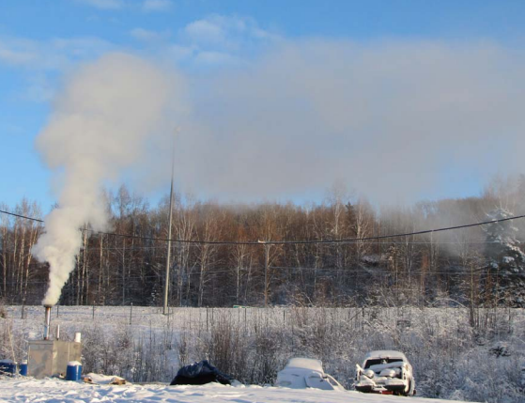
Options to bridge gap over next 10 years
Limit technology choices
Catalytic only
Pellet only
Fuel conversions/removals only
Rely on EPA certification data to develop a subset of acceptable appliances
EPA Certification
Alaska List – subset based on report reviews and more stringent emission limits
Independent Assessment of Residential Wood Heaters

Slide 19
Independent Testing with IDC vs. EPA Certification

Slide 20
Independent assessment of residential wood heaters
Benefits
Bridges gap between now and long-term goal for robust federal program
Will be needed with expected lowering of NAAQS and additional nonattainment areas
Data can be used to advance other areas to reach long term goals
Emission factor development
Method development
Development of standards

Slide 21
Thank you for your time!
Any questions?

