Slide 1
Bioreaction

Slide 2
Bioreactors
Biofilters
Biotrickling filters
Bioscrubbers

Slide 3
Microbial Population Requirements
Sufficient moisture
Sufficient nutrients
Temperature of 60°F to 85°F
pH of 6 to 8

Slide 4
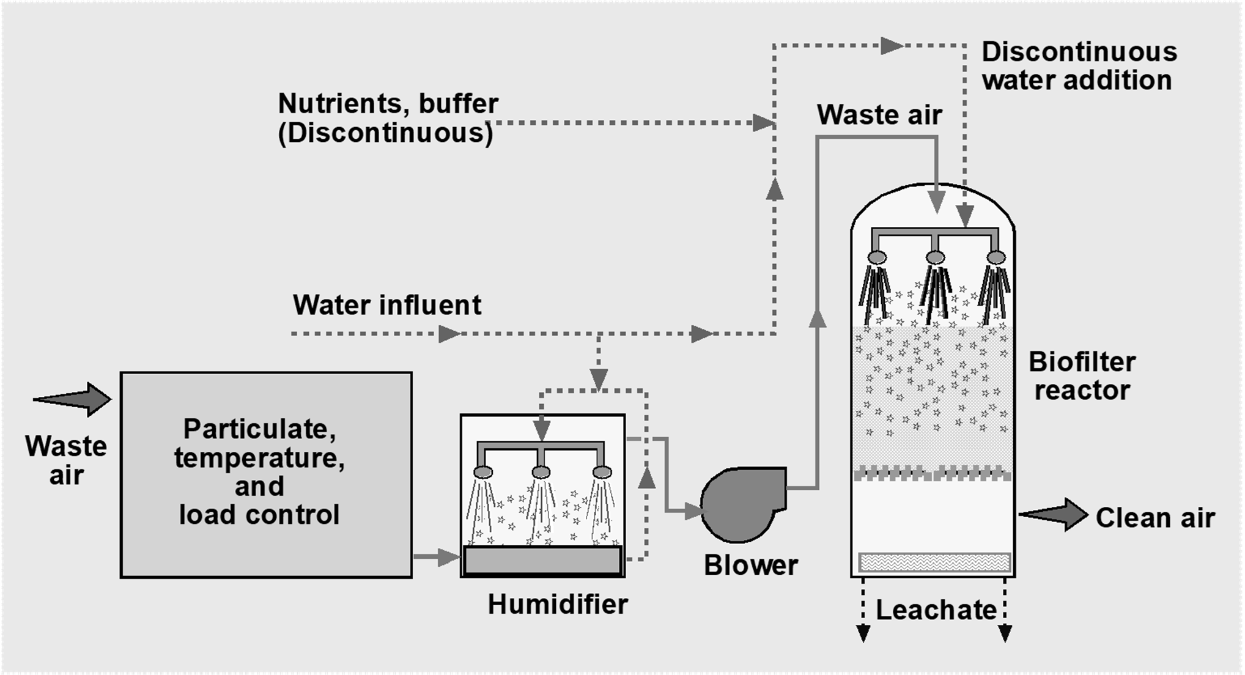
Biofilter System

Slide 5
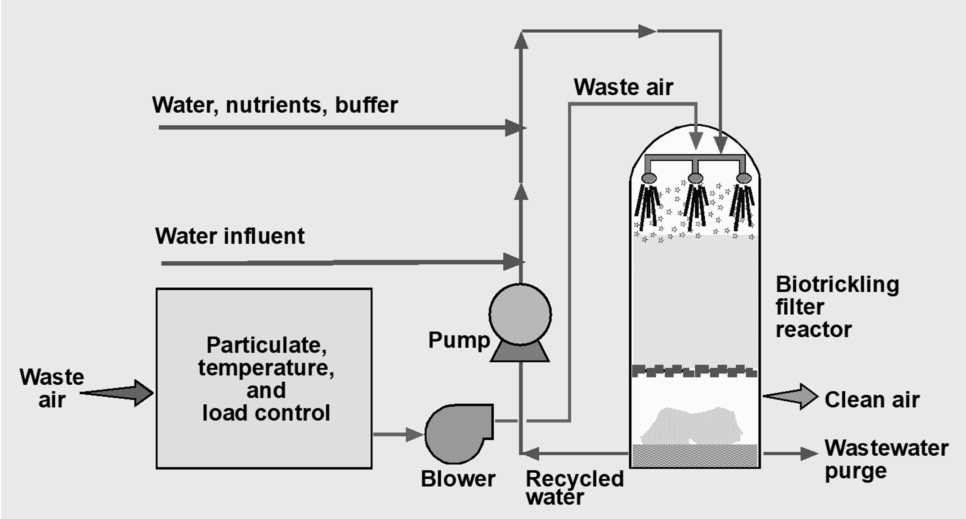
Biotrickling Filter System

Slide 6
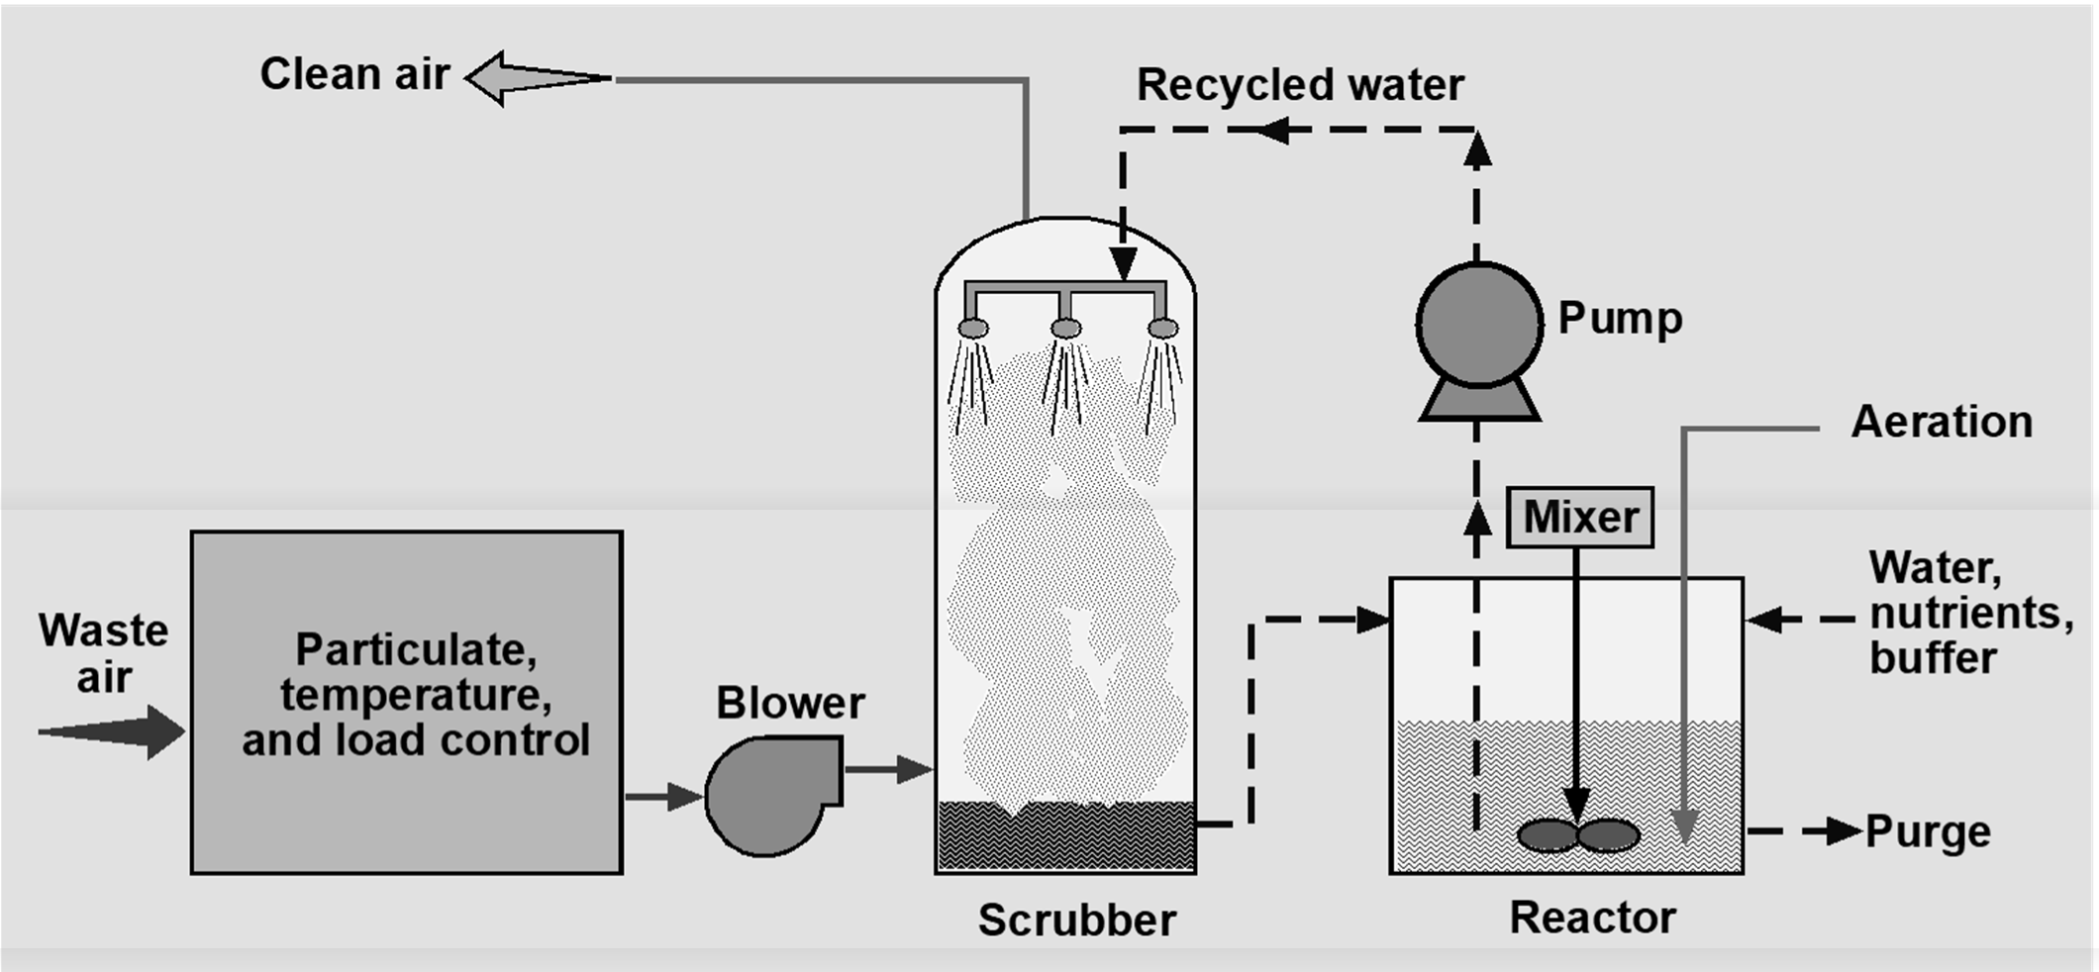
Bioscrubber System

Slide 7
Chapter 6
Oxidation

Slide 8
Types of Oxidization Processes
Flares
Thermal oxidizers
Dedicated units
Process heaters and boilers
Catalytic oxidizers

Slide 9
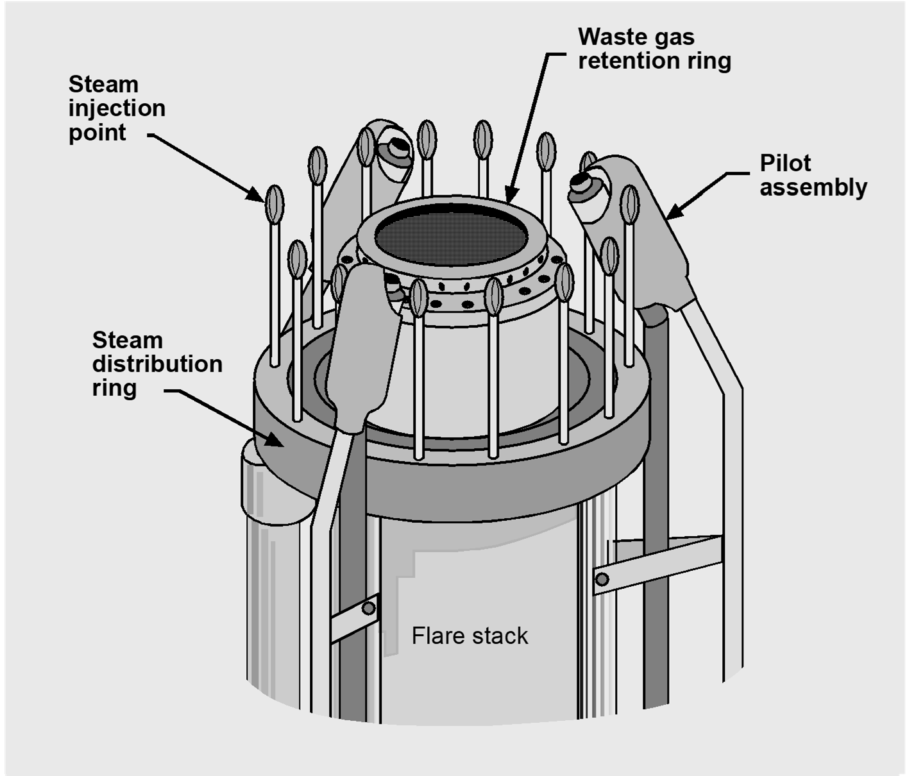
Elevated Flare

Slide 10
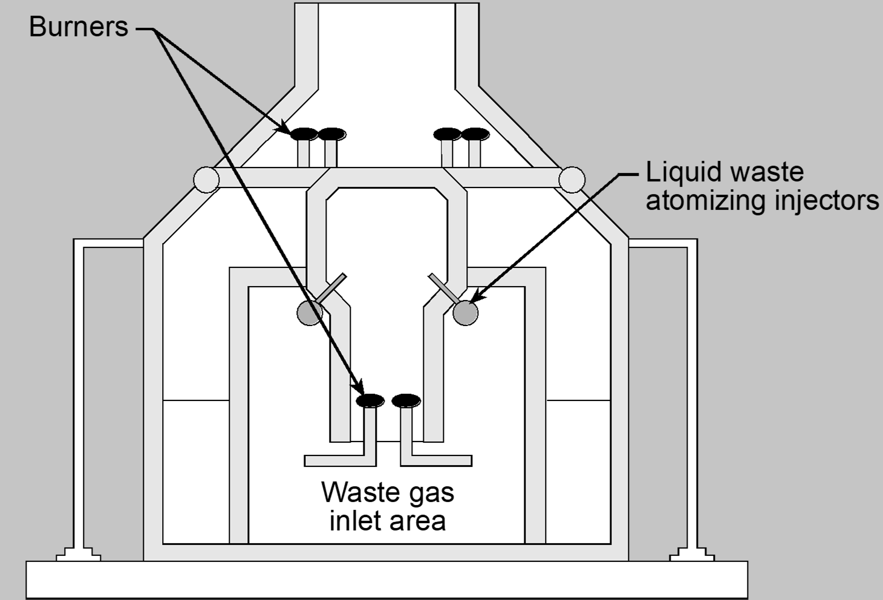
Enclosed Ground Flare

Slide 11
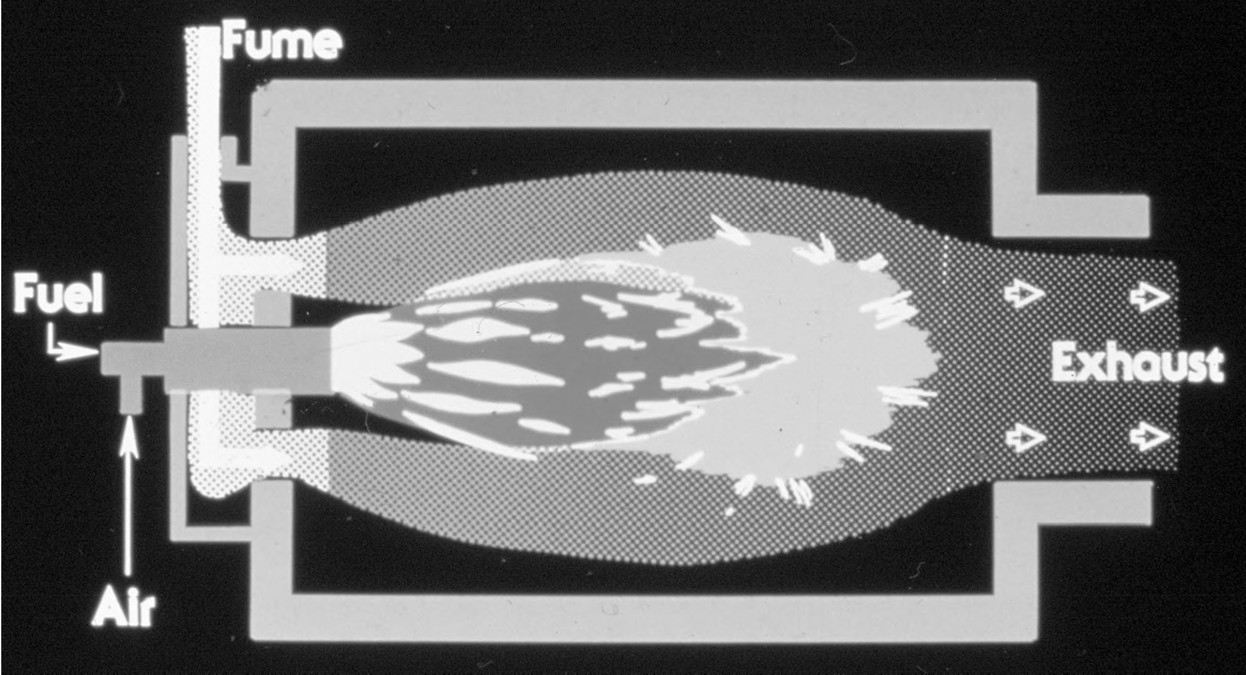
Thermal Oxidizer

Slide 12
Parameters Affecting Performance
Temperature
Residence time
VOC composition and concentration

Slide 13
Temperature
>100°F above auto-ignition temperature
Reaction rate increases with temperature
>1,300°F to convert CO to CO₂
• Typically 1,300-1,800°F

Slide 14
Auto-ignition Temperatures
Compound | Temperature (°F)
Acetone | 870
Acetonitrile | 970
Isopropyl Alcohol (IPA) | 780
Methanol | 878
Methyl Ethyl Ketone | 759
Toluene | 896
Xylene | 867

Slide 15
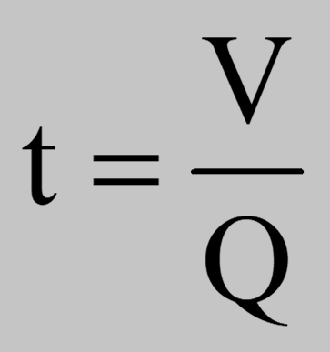
Residence Time
Q = actual volumetric flow rate V = effective volume
Typically 0.3-2.0 seconds

Slide 16
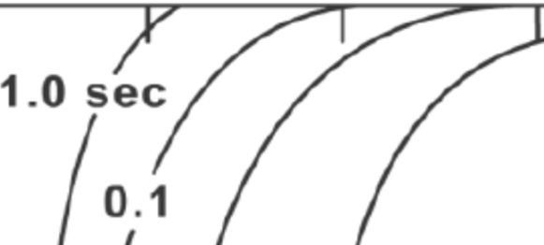


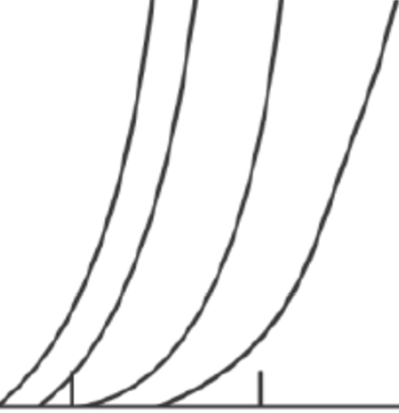
100
0
...
80
c
...
Residence time
<.>
...
60
"C1>'
".'.C.
c
.."...'.
0
D..
0.001
40
20
600
800 1000
1200 1400
Temperature , °F
1600
1800

Slide 17
VOC Composition and Concentration
Composition affects oxidation temperature
Reaction rate increases with concentration
Source of energy
100% LEL vapors contain about 50 Btu/scf
Oxidizing 1% LEL causes about a 27°F temperature rise in the gas stream

Slide 18
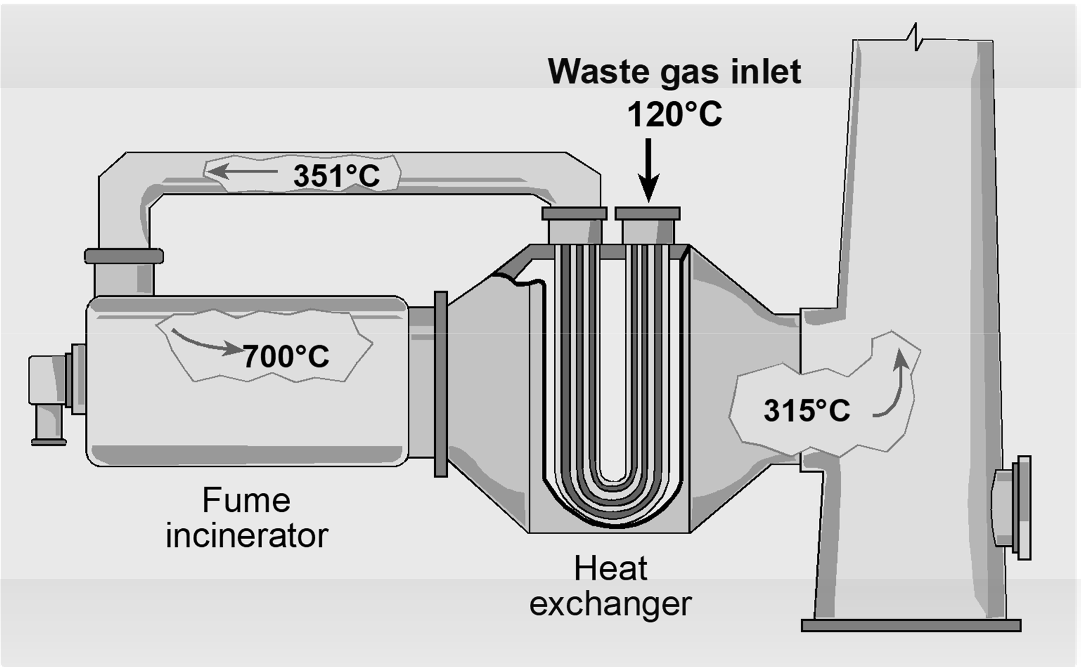
Recuperative Thermal Oxidizer

Slide 19
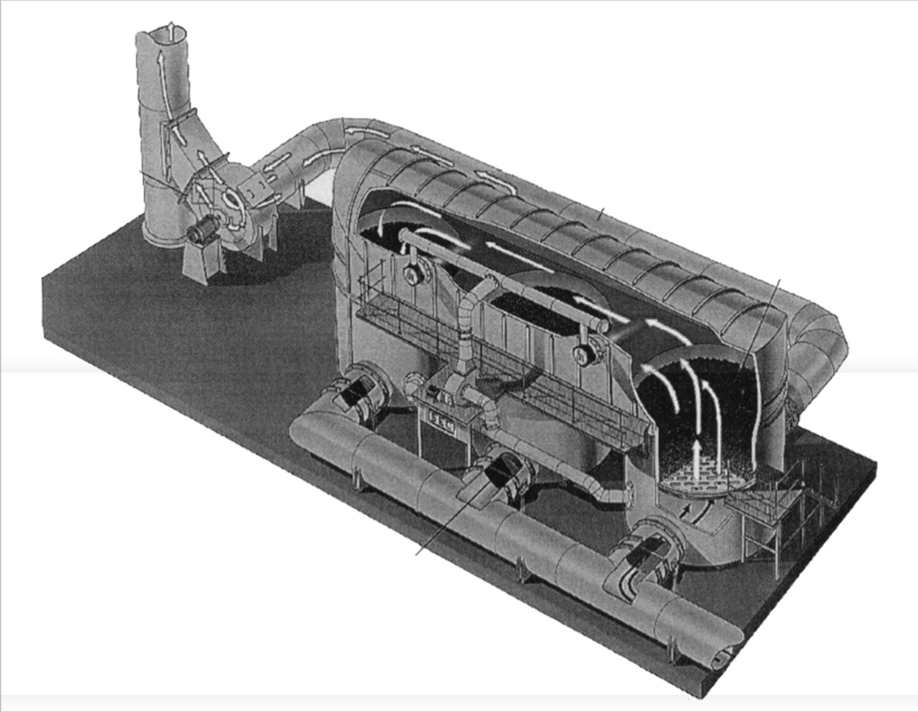
Regenerative Thermal Oxidizer
Induced draft fan
Ceramic media
Valves

Slide 20
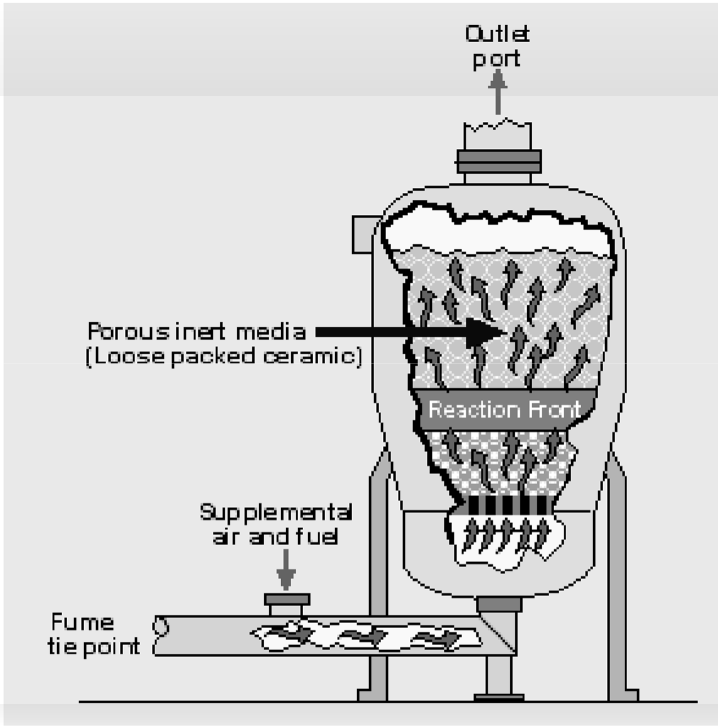
Flameless Thermal Oxidizer

Slide 21
Process Heaters and Boilers
Boiler must operate at 40-100% of full load
Contaminated gas stream flow rate should be small portion of total
Nothing corrosive or that causes deposits

Slide 22
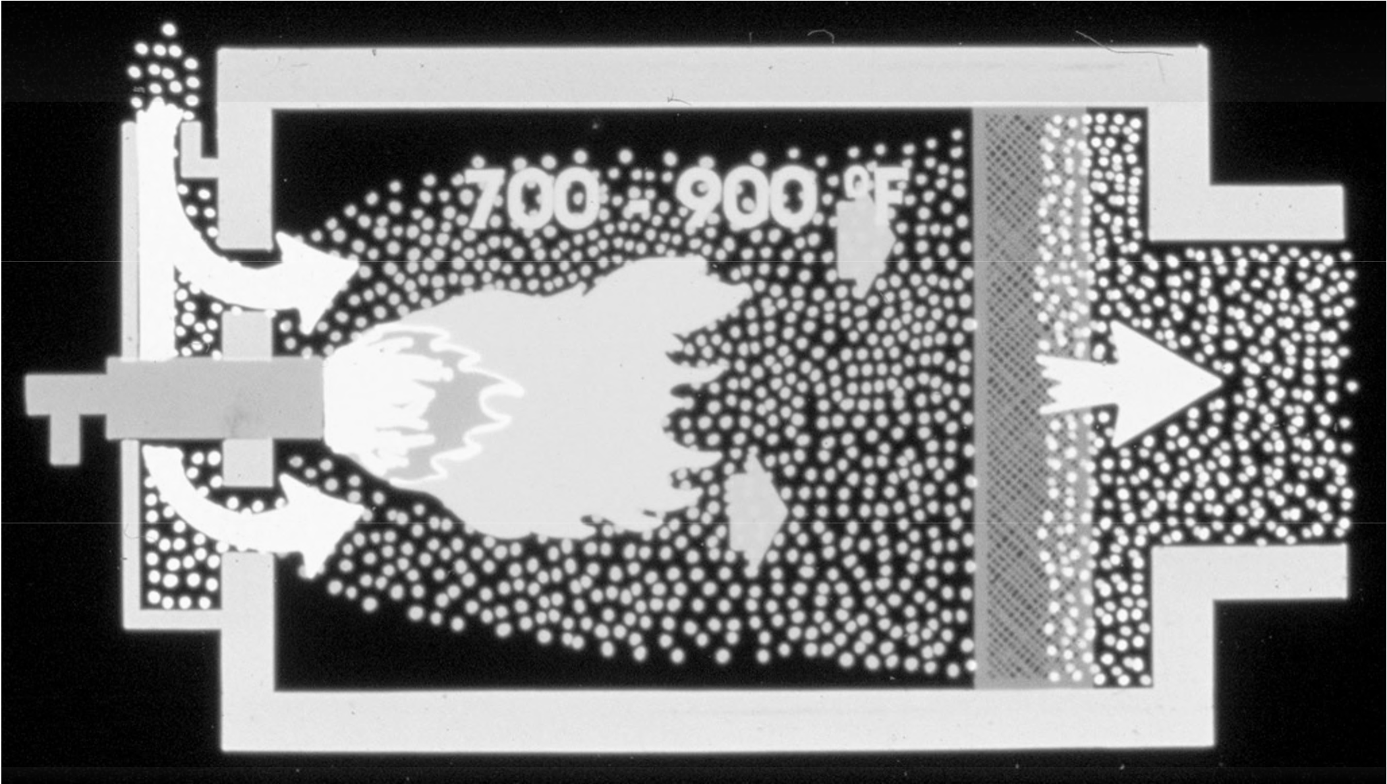
Catalytic Oxidizer

Slide 23

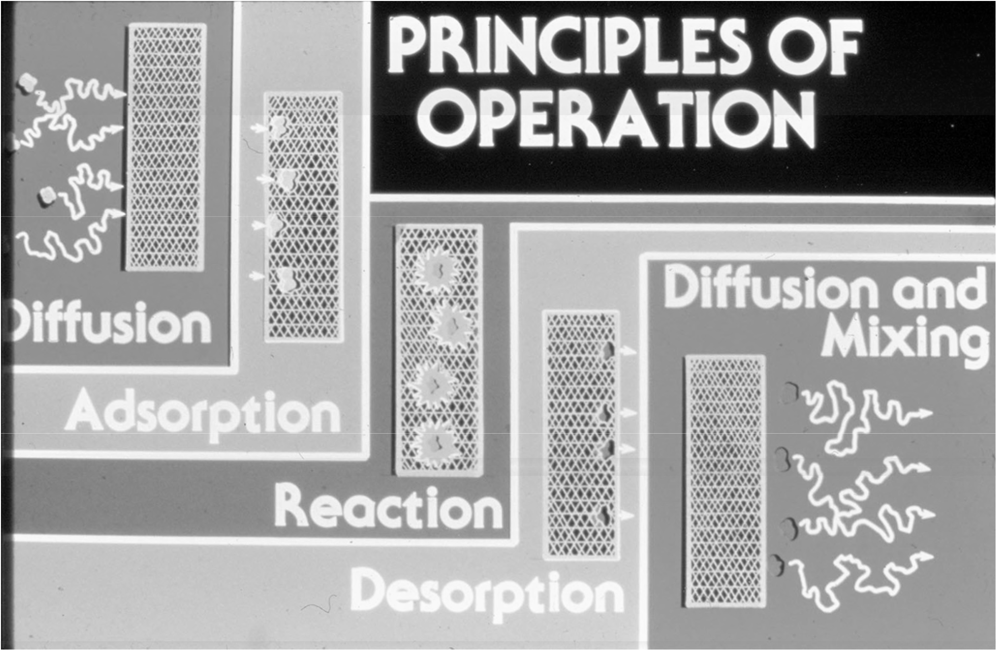

Slide 24
Catalyst Materials
Noble metal oxides
Platinum
Palladium
Rhodium
Base metal oxides
Manganese
Chromium
Vanadium

Slide 25
Catalyst Configurations
Fixed bed
Beaded
Monolithic
Fluidized bed

Slide 26
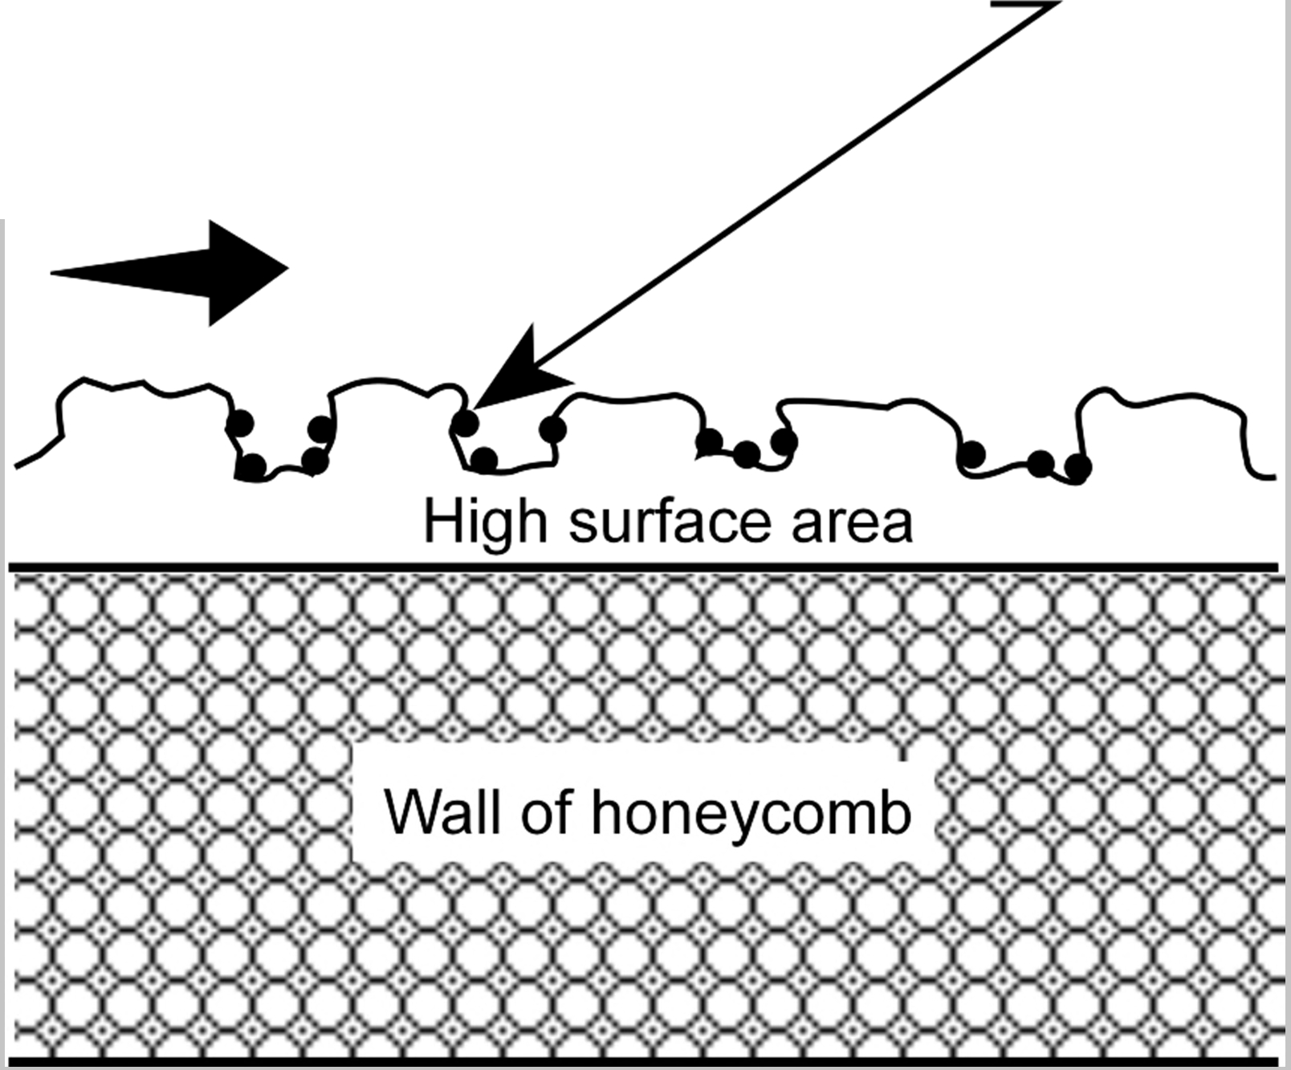
Active precious metal site Exhaust gas

Slide 27
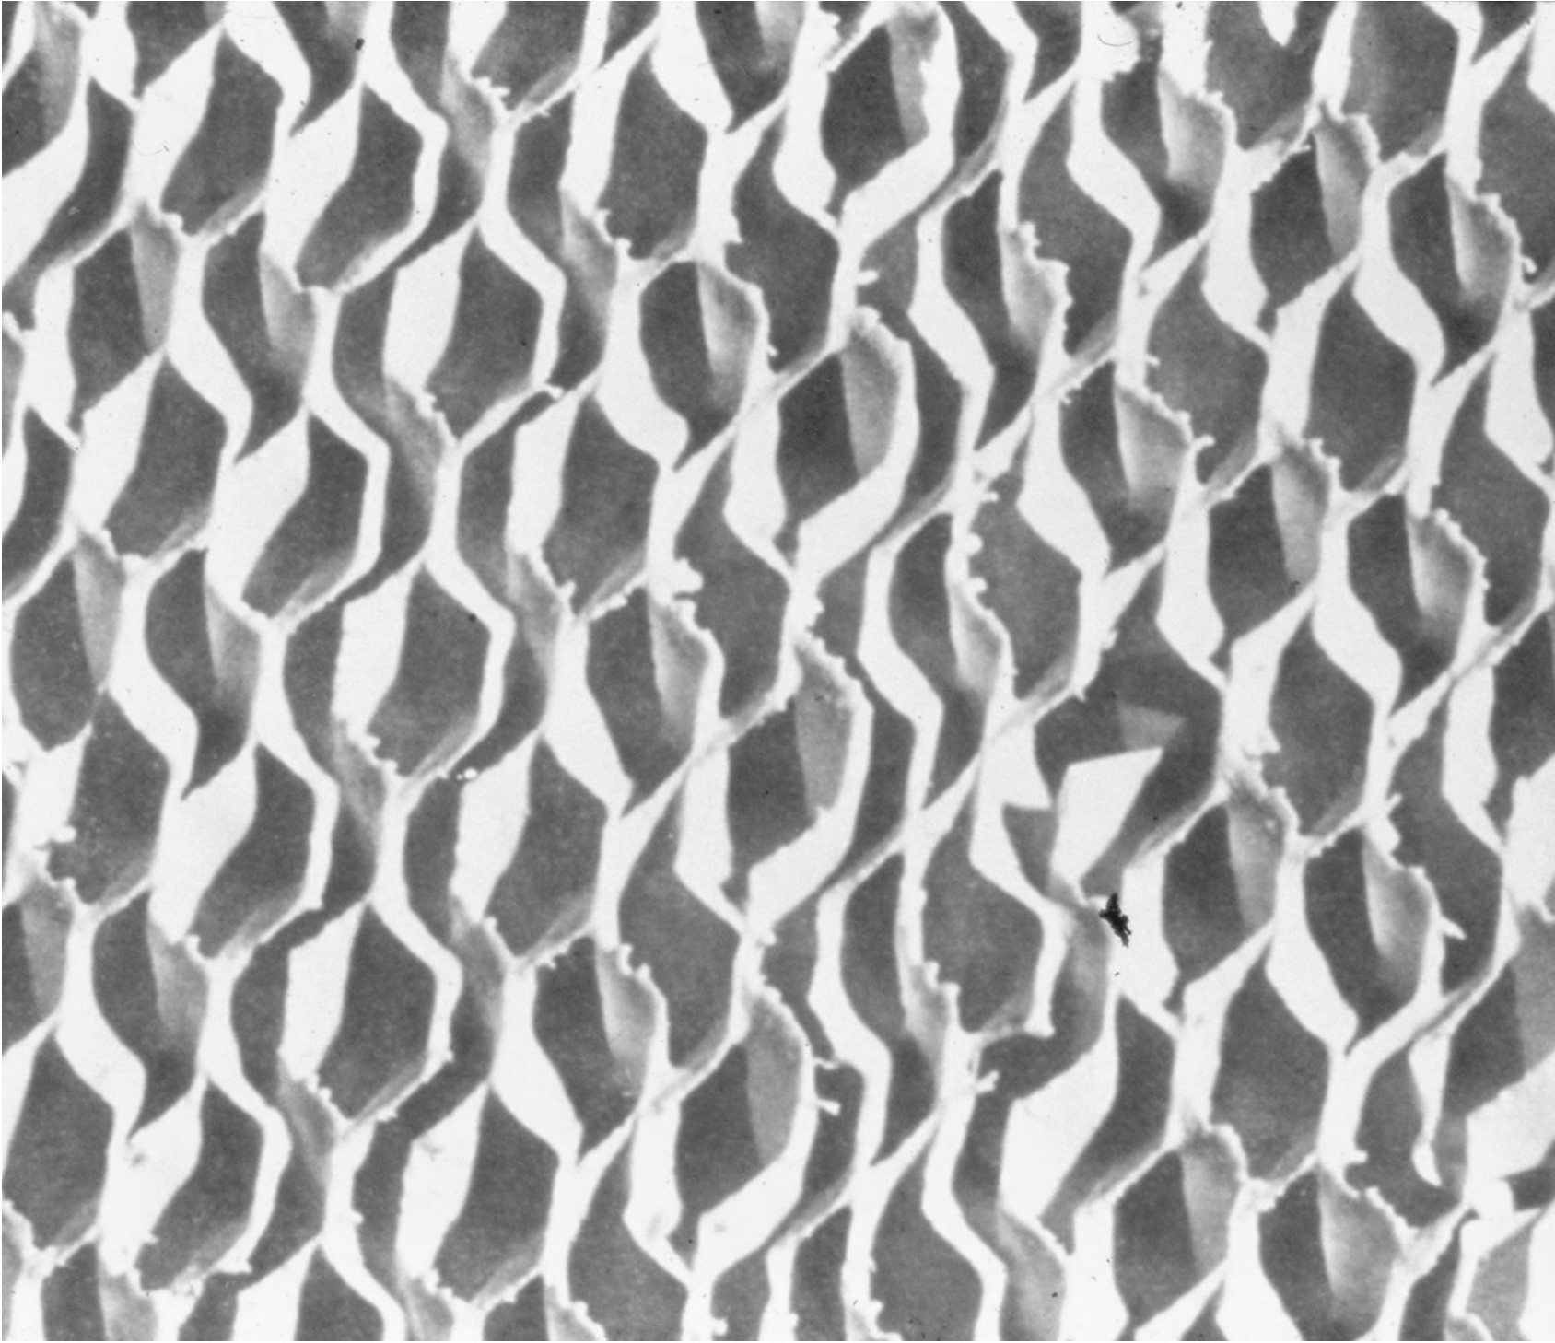

Slide 28
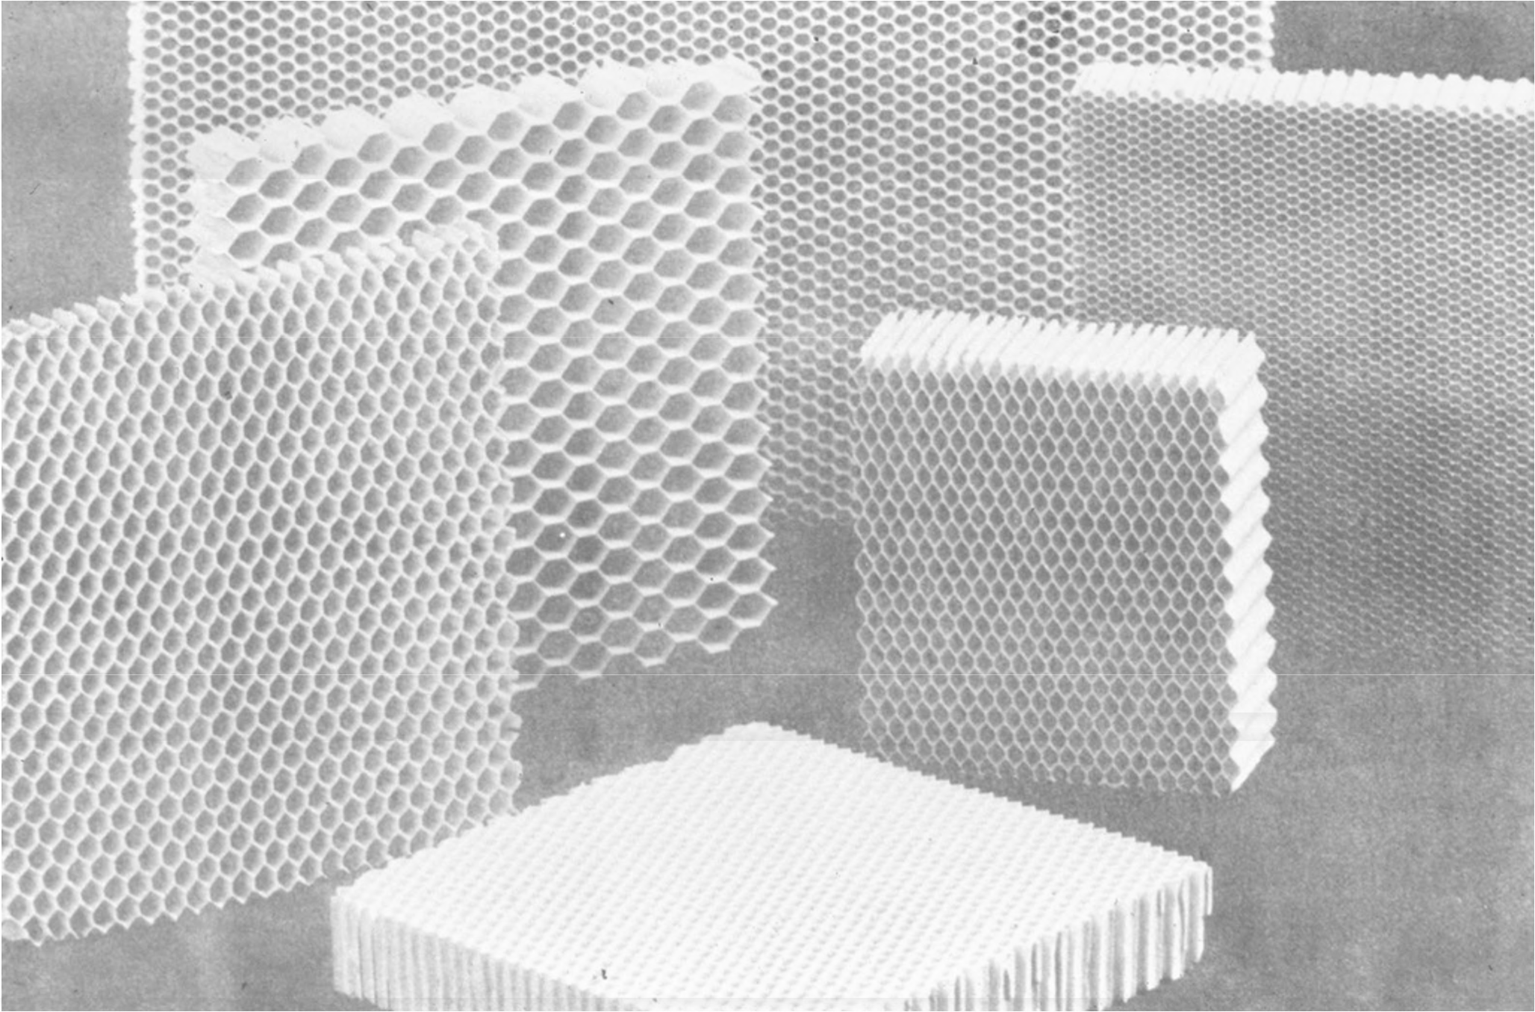

Slide 29
Parameters Affecting Performance
Temperature
Space velocity
VOC composition and concentration
Presence of poisons or inhibitors

Slide 30
Temperature
~100°F above light-off temperature
Reaction rate increases with temperature
Typical inlet temperature: 500-600°F
Typical outlet temperature: 700-900°F
Maximum outlet temperature: 1,100-1,200°F

Slide 31
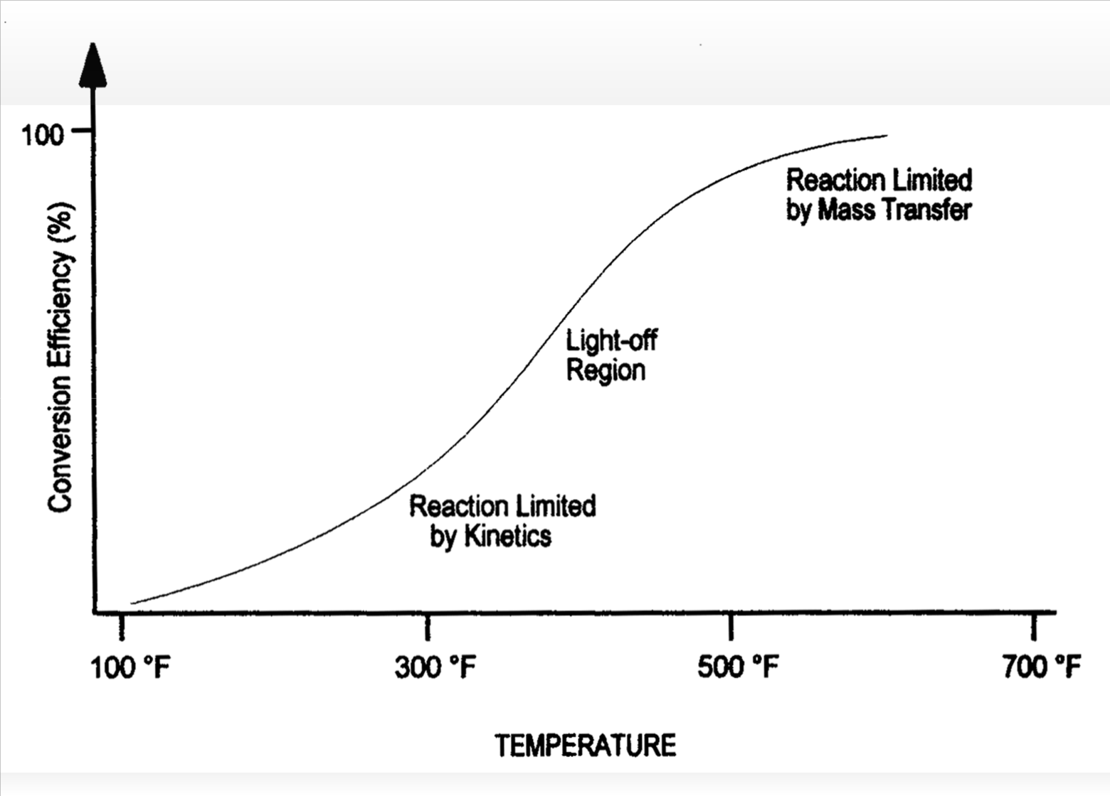
Generic Light-Off Curve

Slide 32
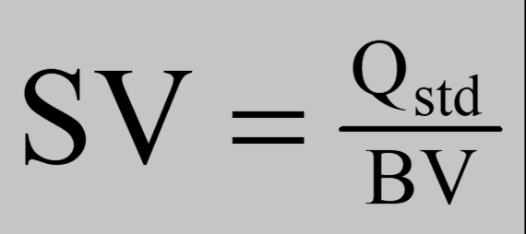
Space Velocity
Q_{std} = standard volumetric flow rate (60°F) BV = catalyst bed volume
Efficiency increases with decreasing space velocity
Typically 30,000-40,000 hr⁻¹ for noble metals 10,000-15,000 hr⁻¹ for base metals

Slide 33
VOC Composition and Concentration
Composition affects oxidation temperature
Reaction rate increases with concentration
Source of energy
100% LEL vapors contain about 50 Btu/scf
Oxidizing 1% LEL causes about a 27°F temperature rise in the gas stream

Slide 34
Catalyst Performance Problems
Fouling
Poisoning
Masking
Thermal aging

Slide 35
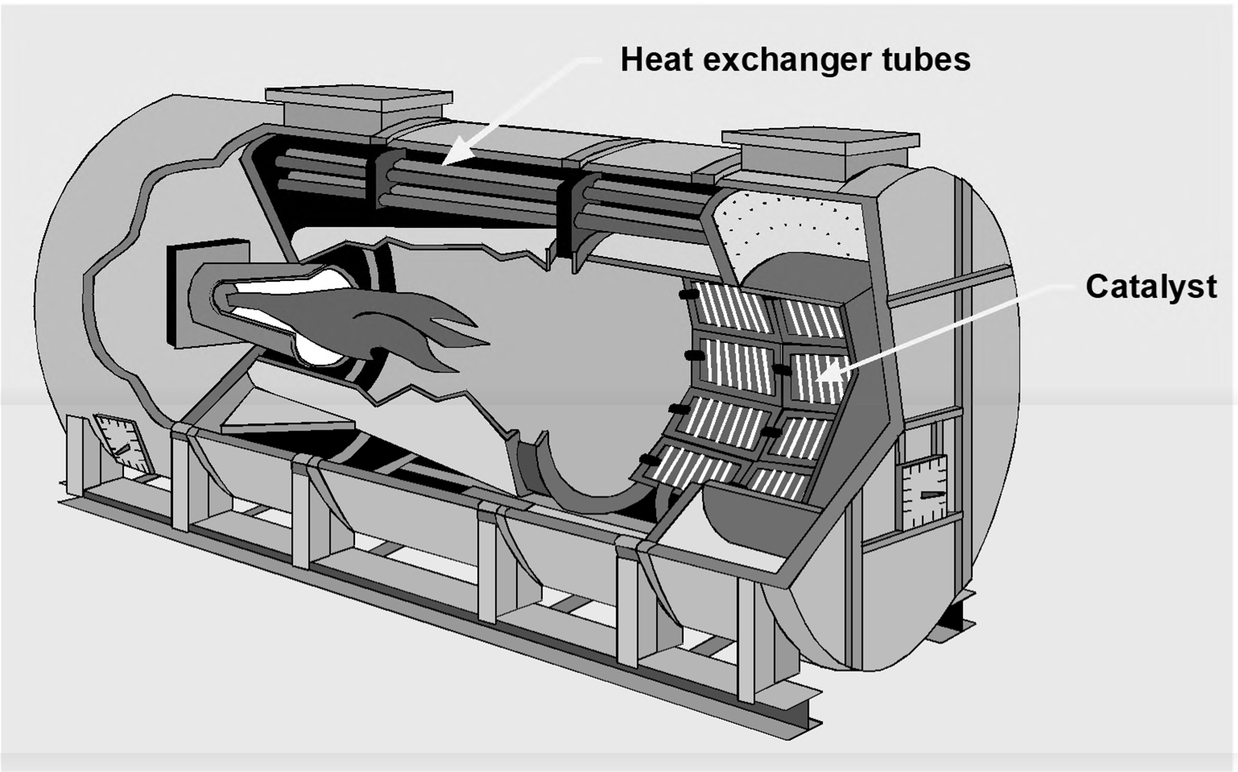
Catalytic Oxidizer

Slide 36
Instrumentation
Temperatures
VOC concentration

Slide 37
Design Review
Temperature
Combustion air requirements
Residence time
Fuel requirements
Required temperature increase
Heat from combustion of contaminants
Available heat from combustion of fuel

Slide 38
Design Review
Temperature
Combustion air requirements
Residence time
Fuel requirements
Required temperature increase
Heat from combustion of contaminants
Available heat from combustion of fuel

Slide 39
Combustion Air Requirements
Stoichiometric air
CH₄ + 2O₂ → CO₂ + 2H₂O
Excess air

Slide 40
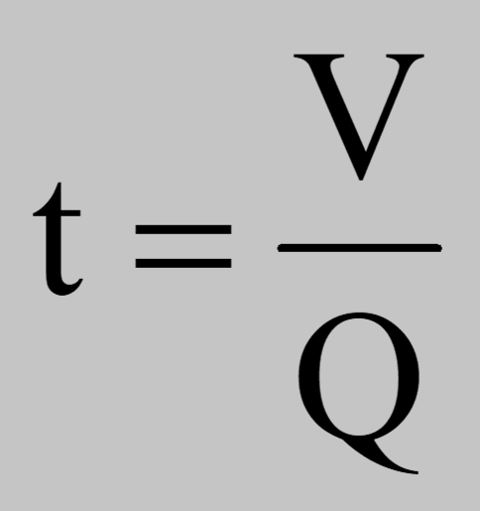
Residence Time
Q = actual volumetric flow rate V = effective volume

Slide 41
Problems 6-1 & 6-2

Slide 42
Design Review
Temperature
Combustion air requirements
Residence time
Fuel requirements
Required temperature increase
Heat from combustion of contaminants
Available heat from combustion of fuel

Slide 43
Heat Content or Enthalpy
(Btu/lb_{m})
Sensible heat
Latent heat

Slide 44
Heat Content Change
H = C_{p}(T - T_{o})
where: | H | = enthalpy, Btu/lb_{m}
 | C_{p} | = specific heat at temperature T, Btu/lb_{m}°F
 | T T_{o} | = temperature of the substance, °F = reference temperature, °F
τ−H = C_{p2} (T₂ - T_{o}) - C_{p1} (T₁
- T_{o})
where:
τ−H = change in enthalpy, Btu/lb_{m}
τ−H = C_{p} (T₂ - T₁)
q = m τ−H = m C_{p} (T₂ - T₁)
where: | q | = heat rate, Btu/hr
 | m | = mass flow rate of gases, lb_{m}/hr

Slide 45
Sensible Heats
Gas Temp. (°F) | O₂ | N₂ | CO₂ | H₂O | Air
60 | 0.0 | 0.0 | 0.0 | 0.0 | 0.0
100 | 8.8 | 6.4 | 5.8 | 17.8 | 9.6
200 | 30.9 | 34.8 | 29.3 | 62.7 | 33.6
300 | 53.4 | 59.8 | 51.3 | 108.2 | 57.8
400 | 76.2 | 84.9 | 74.9 | 154.3 | 82.1
500 | 99.5 | 110.1 | 99.1 | 201.0 | 106.7
600 | 123.2 | 135.6 | 124.5 | 248.7 | 131.6
700 | 147.2 | 161.4 | 150.2 | 297.1 | 156.7
800 | 171.7 | 187.4 | 176.8 | 346.4 | 182.2
900 | 196.5 | 213.8 | 204.1 | 396.7 | 211.4
1000 | 221.6 | 240.5 | 231.9 | 447.7 | 234.1
1100 | 247.0 | 267.5 | 260.2 | 499.7 | 260.5
1200 | 272.7 | 294.9 | 289.0 | 552.9 | 287.2
1300 | 298.5 | 326.1 | 318.0 | 606.8 | 314.2
1400 | 324.6 | 350.5 | 347.6 | 661.3 | 341.5
1500 | 350.8 | 378.7 | 377.6 | 717.6 | 369.0
2000 | 484.5 | 523.0 | 531.4 | 1003.1 | 509.5
2500 | 621.0 | 672.3 | 690.2 | 1318.1 | 654.3

Slide 46
Heat Produced by Combustion
Gross heating value
Sensible and latent heat lost in flue gases
Available heat
Net heating value
Sensible heat lost in flue gases
Available heat

Slide 47
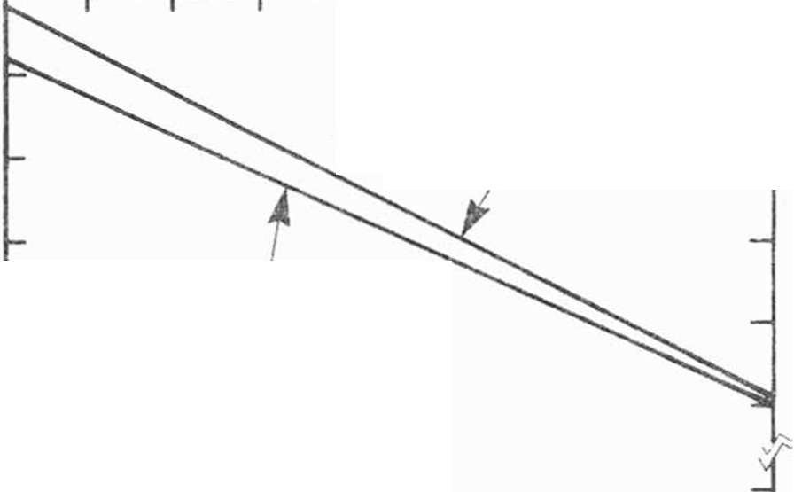
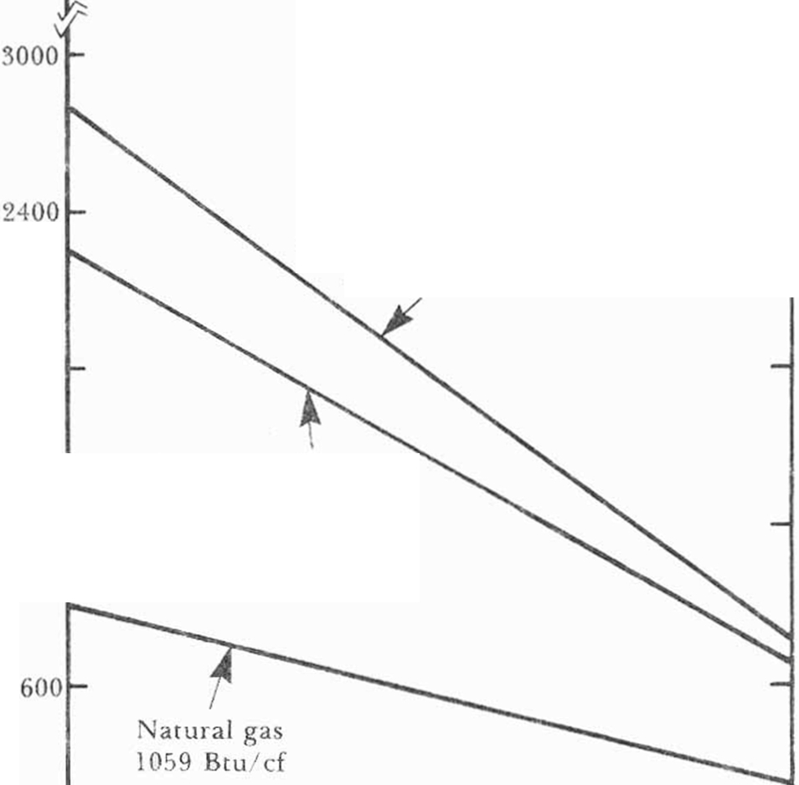

-
:::- 140 000 r-
"T"'"""---
---.
.-- .....--- --.
--
Q I
C'3
120.000
_,
_,
I kavy fuel oil 14 ° A Pl I °J('.. 000 Bt u gal
_,
100.000
c.s
v
.c
v
...0
80,000
nl
Light fuel oil 36.5° A P!
138.000 Etu 'ga l
..,
;...
<
60 .000
40 .000
Commercial buta ne
32 10 Btu/ cf
1800
Commercial propa ne
2558 Bt u 1cf
1200
o---- ----, --
300 900
. .......... . -- ---
1500 2100 2700
Flue gas exi t lt>m pt•rc1 t t11<'. ⁰ f

Slide 48
Problem 6-3

Slide 49
Chapter 7
Condensation

Slide 50
Types of Condensation Systems
Conventional systems
Refrigeration systems
Cryogenic systems

Slide 51
Types of Condensers
Direct contact condensers
Surface condensers

Slide 52
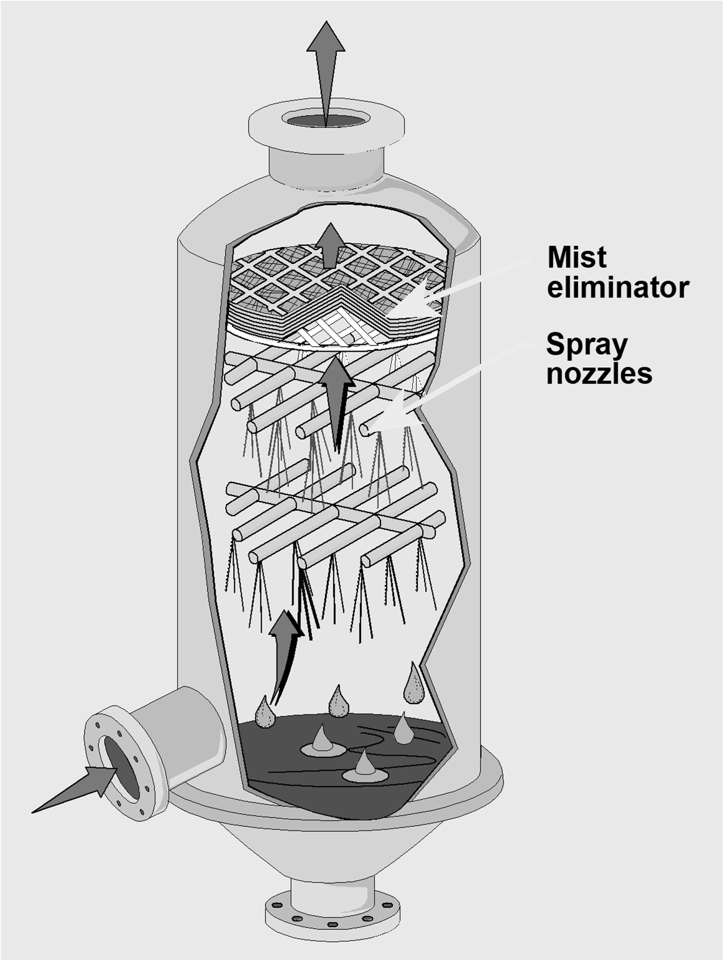
Direct Contact Condenser

Slide 53
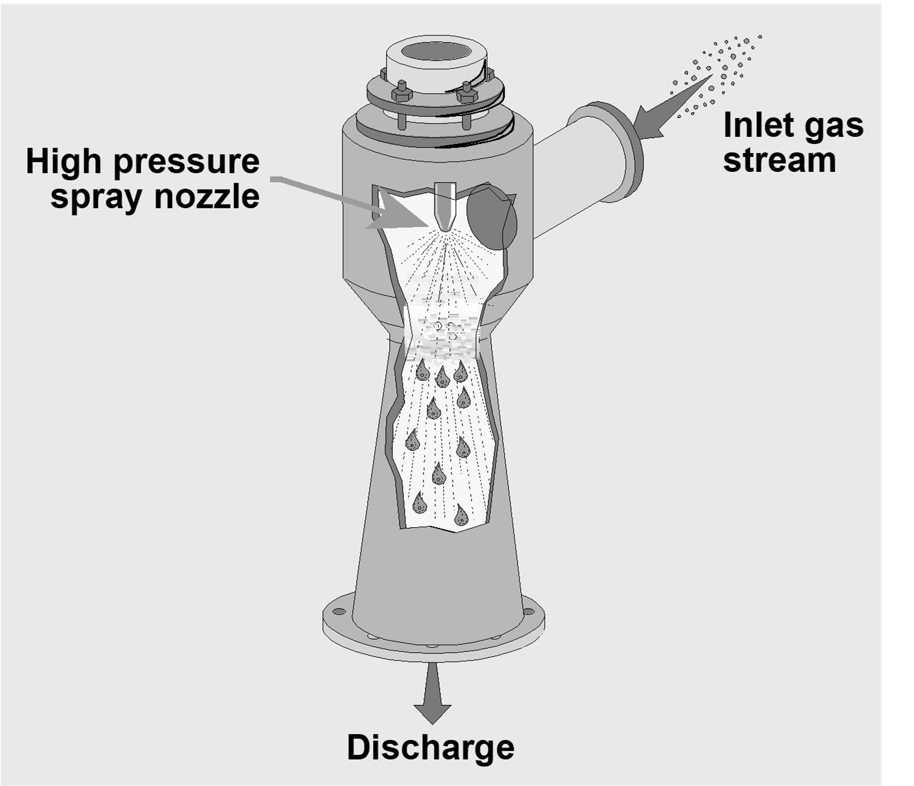
Ejector Condenser

Slide 54
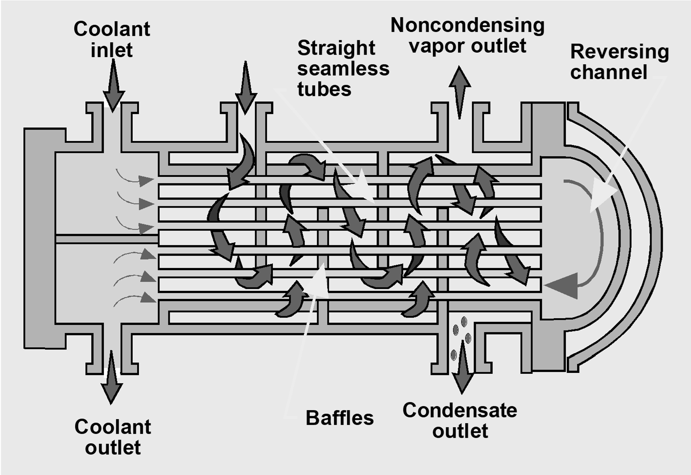
Shell and Tube Condenser

Slide 55
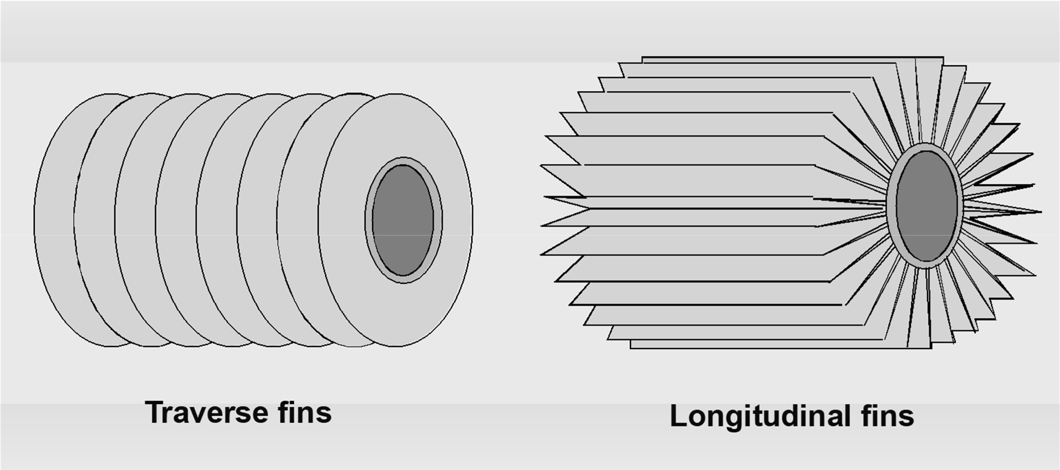
Tube and Fin Condenser

Slide 56
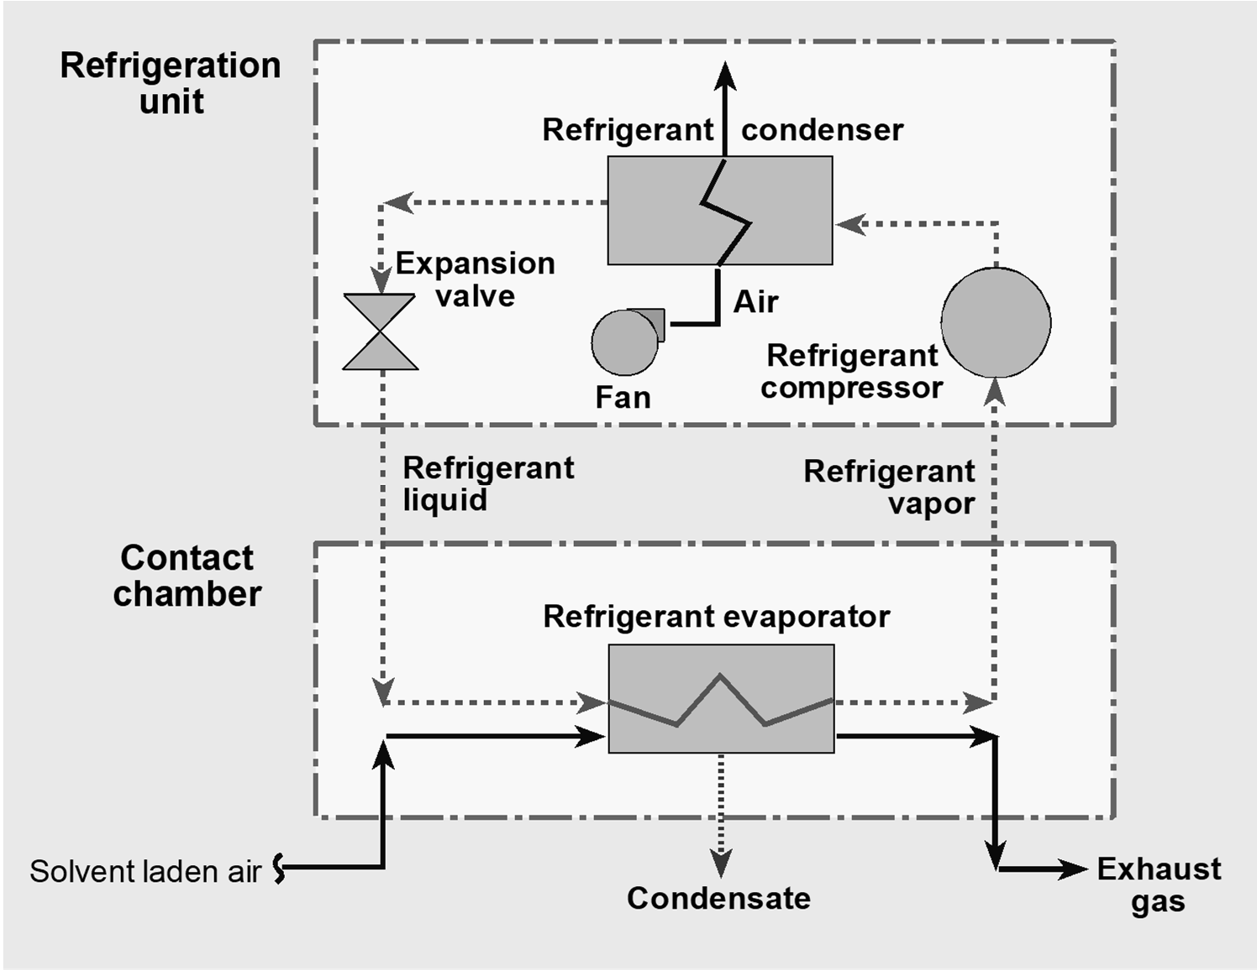
Refrigeration Cycle

Slide 57
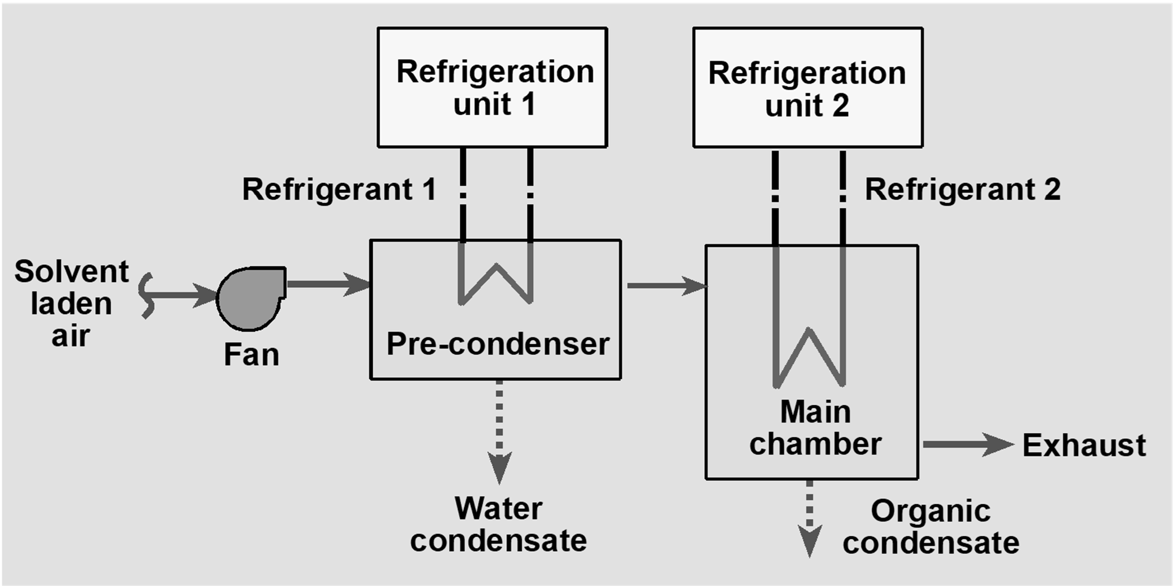
Refrigeration System

Slide 58
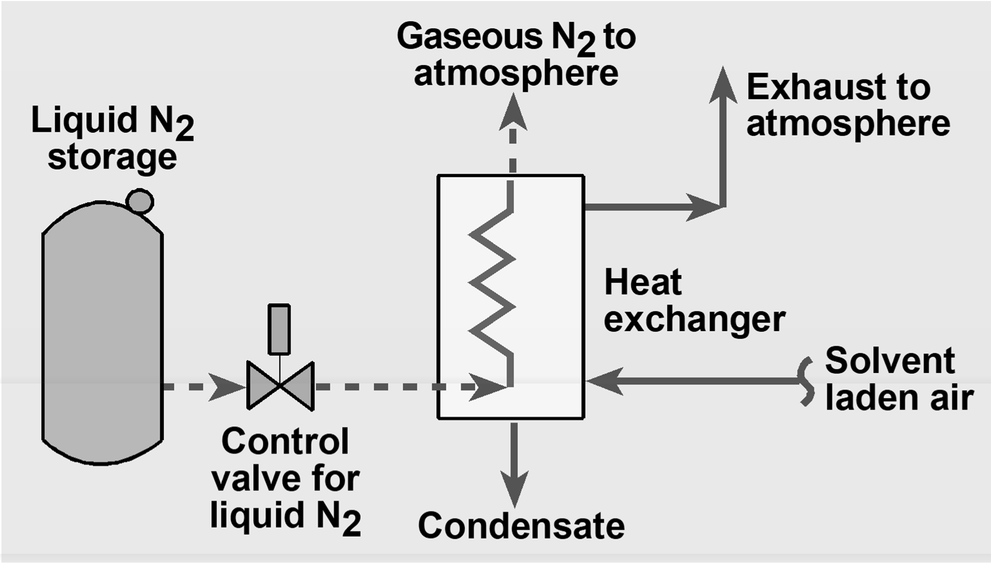
Single Heat Exchanger Cryogenic System

Slide 59
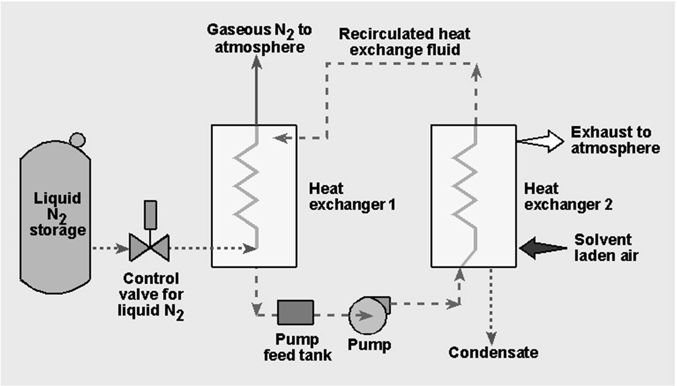
Dual Heat Exchanger Cryogenic System

Slide 60
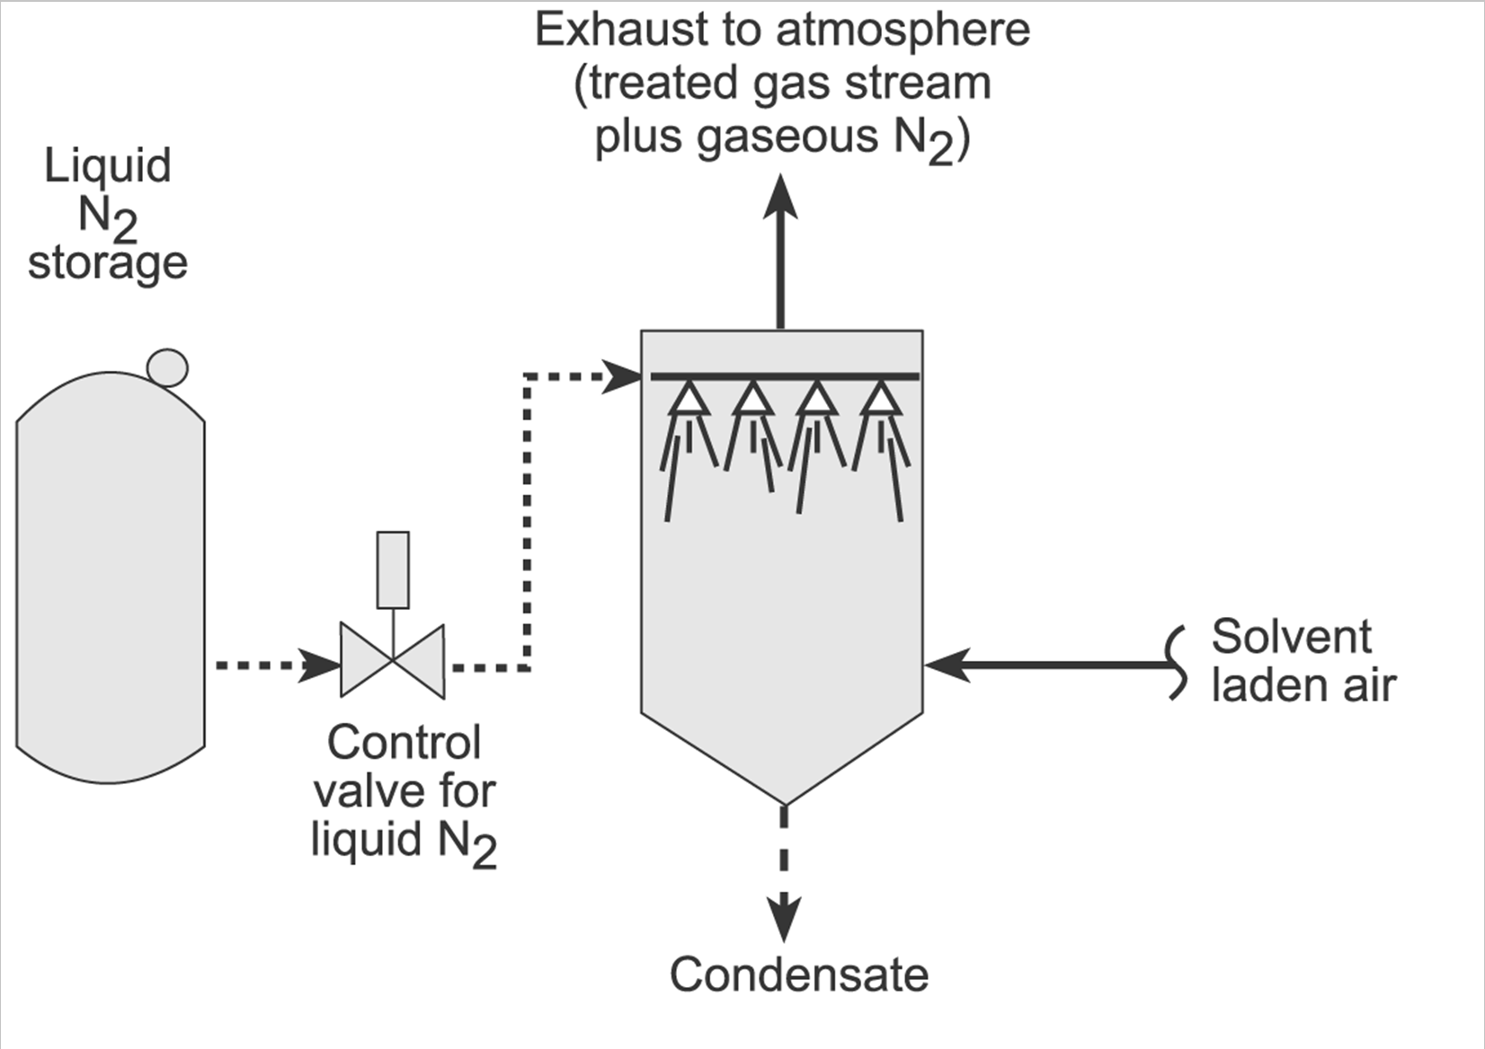
Direct Contact Cryogenic Condenser

Slide 61
Instrumentation
Outlet gas temperature
Coolant flow rate
Coolant temperatures

Slide 62
Design Review
Outlet concentration
Contact condenser coolant flow rate
Surface condenser surface area

Slide 63
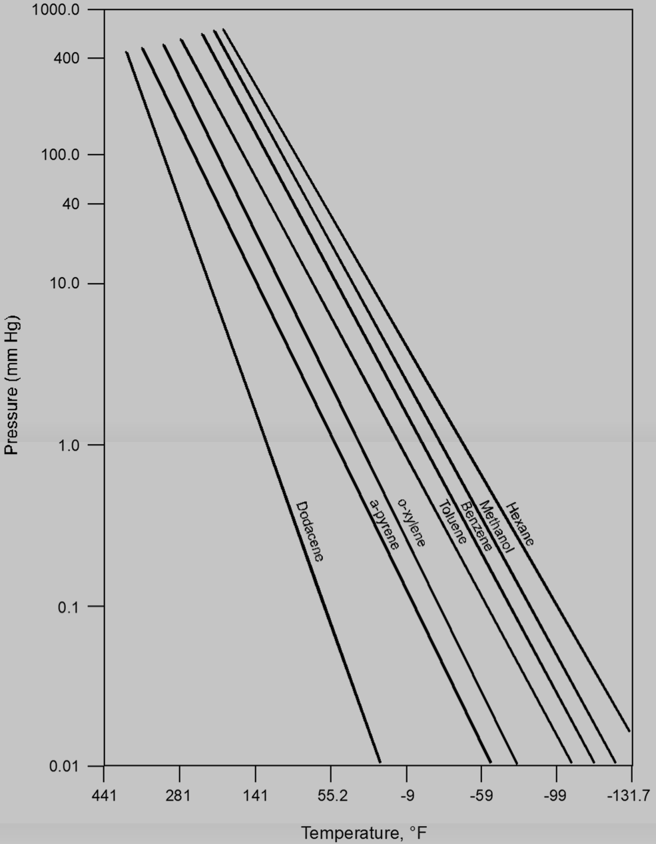
Vapor Pressure

Slide 64
Problem 7-1

Slide 65
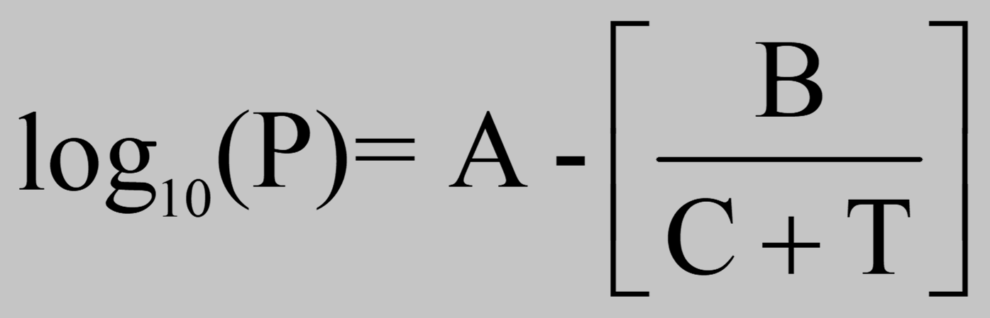
Vapor Pressure
Antoine equation:
where:
P T
= vapor pressure, mm Hg
= temperature, °C
A,B,C = constants

Slide 66
Problem 7-2

Slide 67
Contact Condenser Coolant Flow Rate
q = mC_{pg} (T_{Gi} - T_{cond}) + mH_{l} + mC_{pc} (T_{cond} - T_{Lo}) = LC_{pl}(T_{Lo} - T_{Li})
where:
q = heat transfer rate, Btu/hr
m = mass flow rate of vapor, lb_{m}/hr
L = mass flow rate of liquid coolant, lb_{m}/hr
C_{p}= average specific heat of a gas, condensate or coolant, Btu/lb_{m} °F
T = temperature of gas or liquid streams, °F H_{l} = heat of condensation, Btu/lb_{m}

Slide 68
Surface Condenser Surface Area
q = U A (φλT_{m})
where:
q | = | heat transfer rate, Btu/hr
U A | = = | overall heat transfer coefficient, Btu/hr·ft²·°F heat transfer surface area, ft²
ΔT_{m}= log mean temperature difference, °F

Slide 69
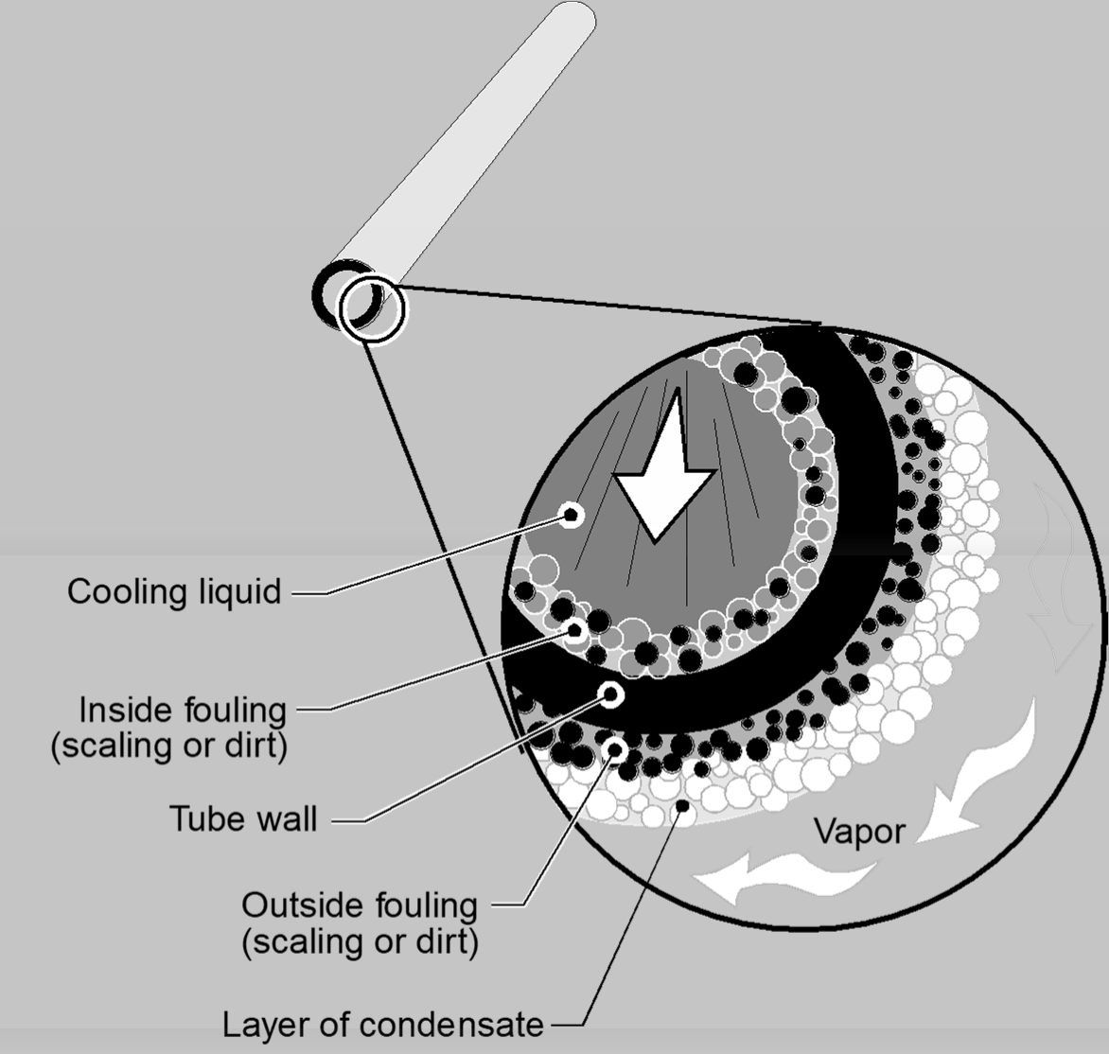
Heat Transfer Resistances

Slide 70
Overall Heat Transfer Coefficients
Condensing Material | Cooling Liquid | U, Btu/hr·ft²·°F
Organic vapor with high percent of noncondensables | Water | 20 - 60
High boiling hydrocarbon vapor (vacuum) | Water | 20 - 50
Low boiling hydrocarbon vapor | Water | 80 - 200
Hydrocarbon vapor and steam | Water | 80 - 100
Steam | Feedwater | 400 - 1000
Water | Water | 200 - 250

Slide 71
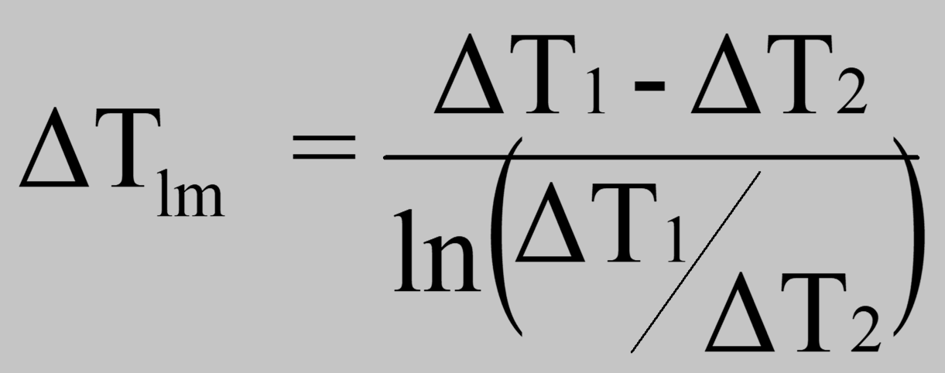
Log Mean Temperature Difference

Slide 72
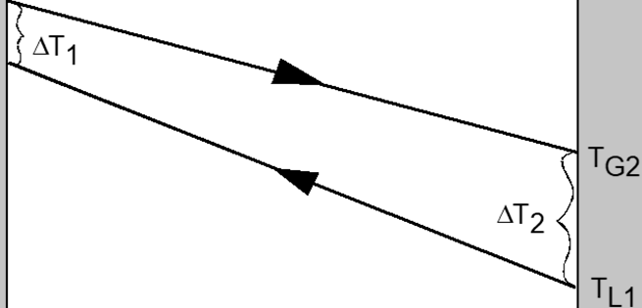
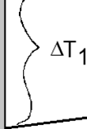
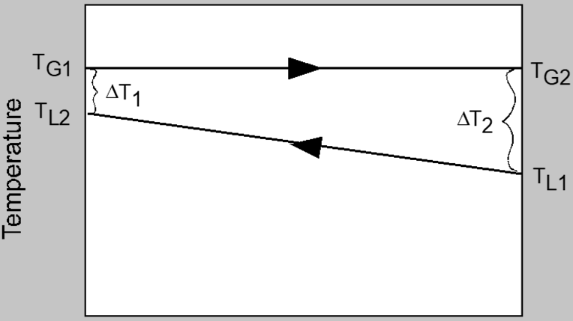
(a) Cocurrent flow
(b) Countercurrent flow
TG1
-
TG1 r;----------.-._ _j
6T2
TL2
-
TL2
:::I
TG2
^{Q}....⁾.
^{r}..º...
:::I
ro
Q)
.....
a.
E
Q)
a.
E
Q)
F TL1
Length of exchanger
Length of exchanger
(c) Isothermal condensation with countercurrent flow
Length of exchanger

Slide 73
Problem 7-3

Slide 74
Chapter 8
Control Techniques for Nitrogen Oxides

Slide 75
NO_{X} Formation Mechanisms
Thermal NO_{X}
Formed by oxidation of nitrogen in the combustion air
Fuel NO_{X}
Formed by oxidation of nitrogen in the fuel
Prompt NO_{X}
Formed by early free-radical reactions in the flame

Slide 76
Thermal NO_{x} Formation
N₂ + O₂ ↔ 2NO
NO + ½ O₂ ↔ NO₂

Slide 77
Factors Affecting Thermal NO_{X} Formation
Flame Temperature
Residence time of combustion gases in peak temperature zone of the flame
Amount of oxygen present in peak temperature zone of the flame

Slide 78

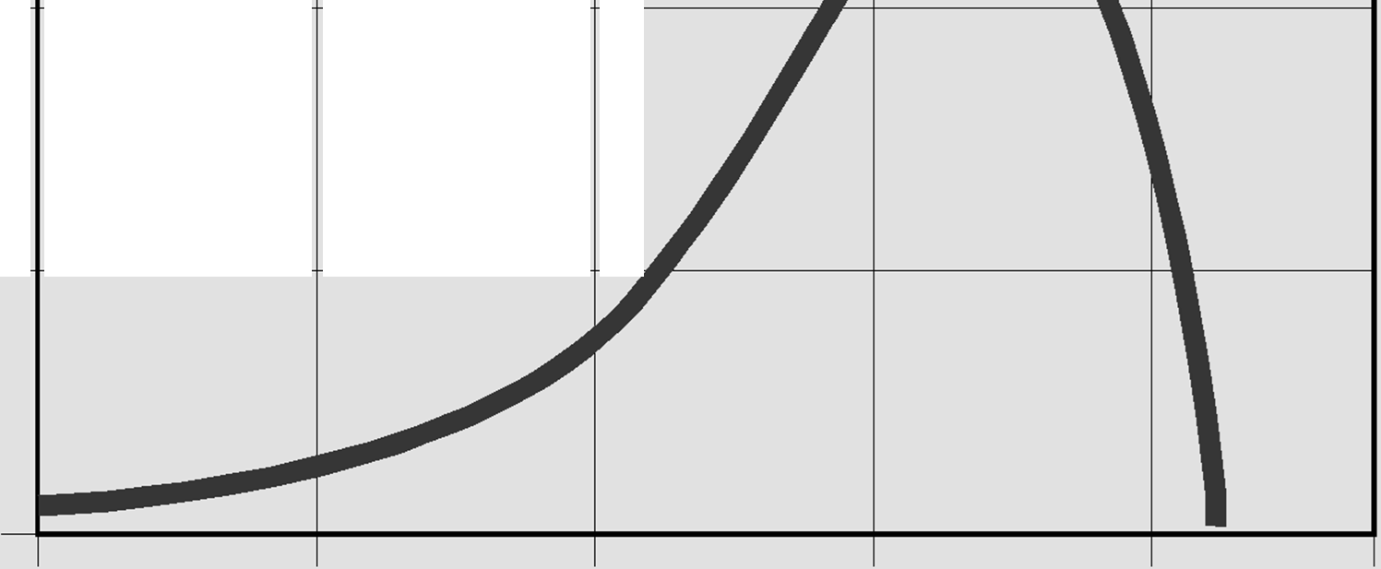
...-...
20----
---+-
--+- -
M
----1
..^{E}.....
C)
.:_1..
><
0
z 10 ----
---+-
---+-
0
1600
1700
1800 1900
Temperature (°C)
2000
2100

Slide 79
Techniques for Reducing Thermal NO_{x}
Reduce peak flame temperature
Reduce residence time at peak flame temperature
Reduce oxygen concentration in maximum temperature zone

Slide 80
Fuel NO_{x} Formation
Occurs by oxidation of organically bound nitrogen contained in the fuel
Coal: 0.2-3.5 weight percent
Fuel oil: 0.01-0.5 weight percent
Natural gas: None
Approximately 20-60% of the fuel nitrogen is oxidized
Amount oxidized decreases as nitrogen content increases

Slide 81
Factors Affecting Fuel NO_{x} Formation
Combustion zone temperature
Oxygen levels in the vicinity of the flame
Fuel nitrogen content

Slide 82
Techniques for Reducing Fuel NO_{X} Formation
Decrease combustion temperature
Decrease oxygen concentration
Decrease fuel nitrogen content

Slide 83
Prompt NO_{x} Formation
Forms early in the combustion process due to free-radical reactions in the flame
Residence time is usually too short to generate high concentrations
Mechanism has greatest impact in fuel rich combustion zones
Mechanism is of minor importance in large-scale combustion systems

Slide 84
Reducing Prompt NO_{X}
Prompt reactions are not sensitive to peak gas temperatures. Therefore, combustion modifications do not have a strong influence on the NO_{X} formed by this mechanism.

Slide 85
NO_{x} Control Systems
Combustion modifications
Fuel switching
Add-on control devices

Slide 86
Boiler Combustion Modifications
Low excess air combustion
Off-stoichiometric combustion
Flue gas recirculation
Low NO_{x} burners
Gas reburning

Slide 87
Boiler Combustion Modifications
Low excess air combustion
Off-stoichiometric combustion
Flue gas recirculation
Low NO_{x} burners
Gas reburning

Slide 88
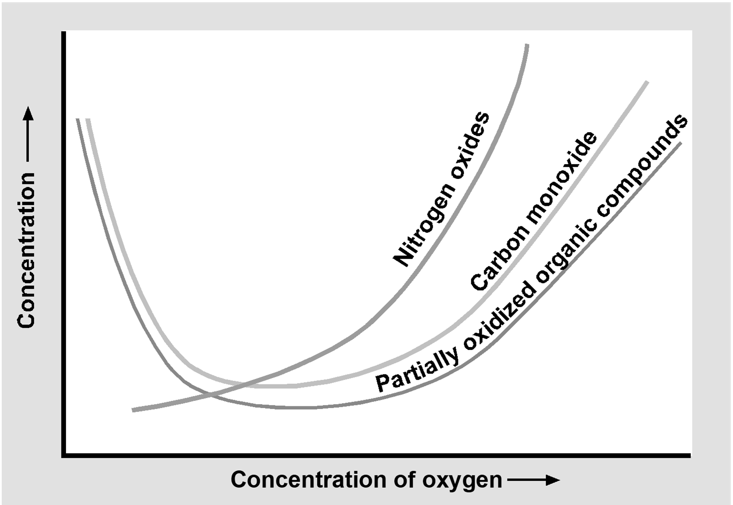
Effect of Oxygen on NO_{x} Formation

Slide 89
NO_{x} Reduction with Low Excess Air Combustion
16-20% for gas- and oil-fired boilers with 2-7% excess air
~20% for coal-fired boilers with 20% excess air

Slide 90
Off-Stoichiometric Combustion
Combustion occurs in two zones
A primary zone with less than stoichiometric air (fuel rich)
A secondary zone where the remaining combustion air is added (air rich)

Slide 91
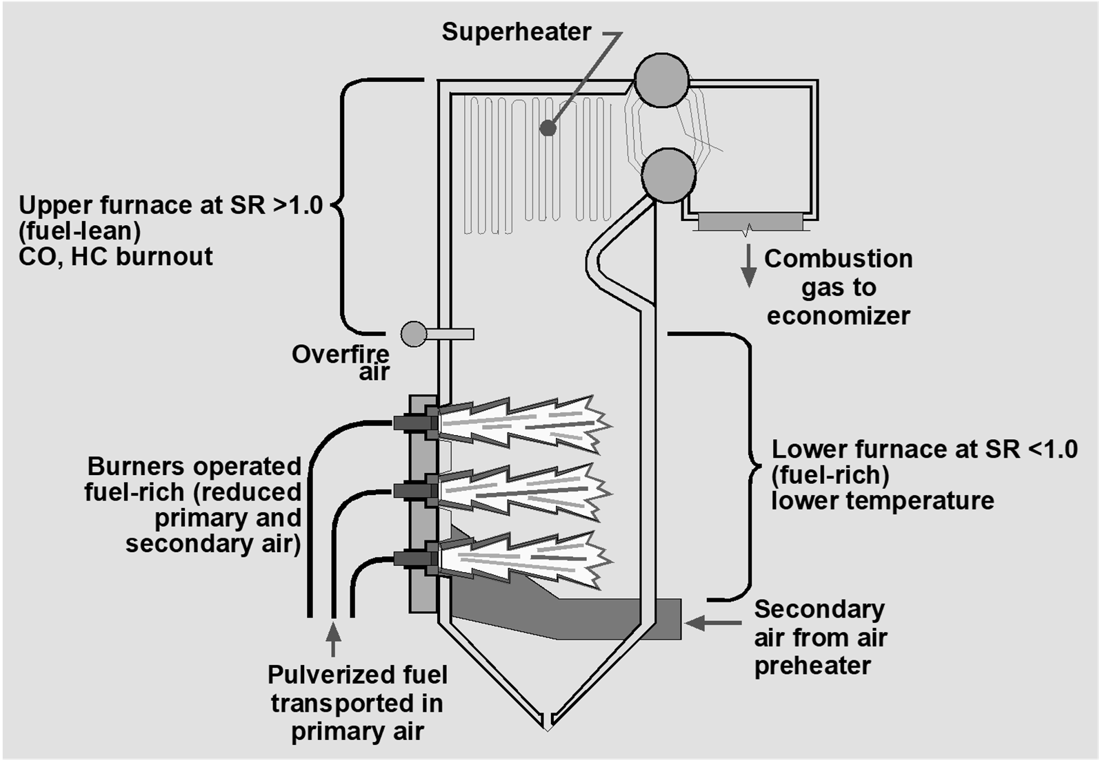
Use of Overfire Air (OFA)

Slide 92
NO_{x} Reduction with
Off-Stoichiometric Combustion
30-40% for gas- and oil-fired boilers
30-50% for coal-fired boilers

Slide 93
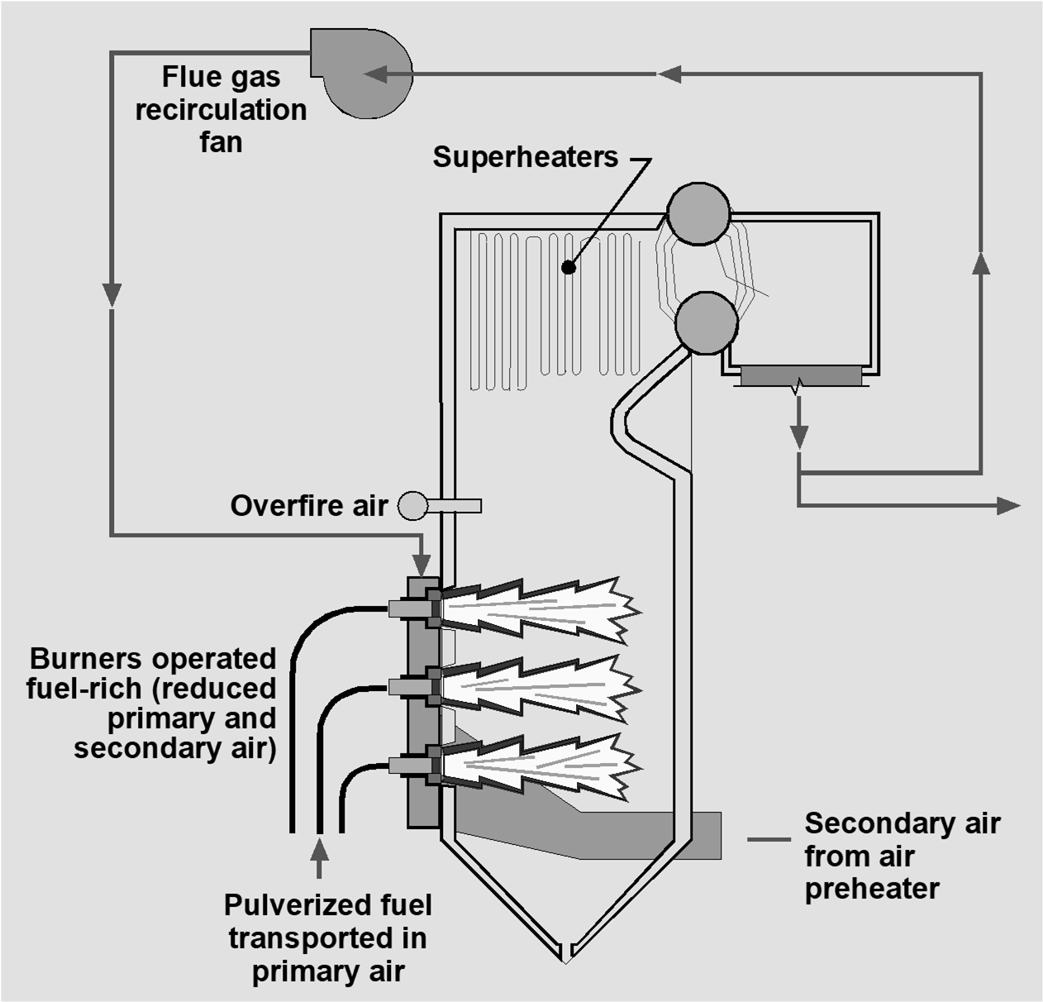
Flue Gas Recirculaton (FGR)

Slide 94
NO_{x} Reduction with Flue Gas Recirculation
40-50% with recirculation of 20-30% of the exhaust gas in gas- and oil-fired boilers

Slide 95
Low NO_{X} Burners
Control techniques
Low excess air
Off-stoichiometric combustion
Combustion gas recirculation

Slide 96
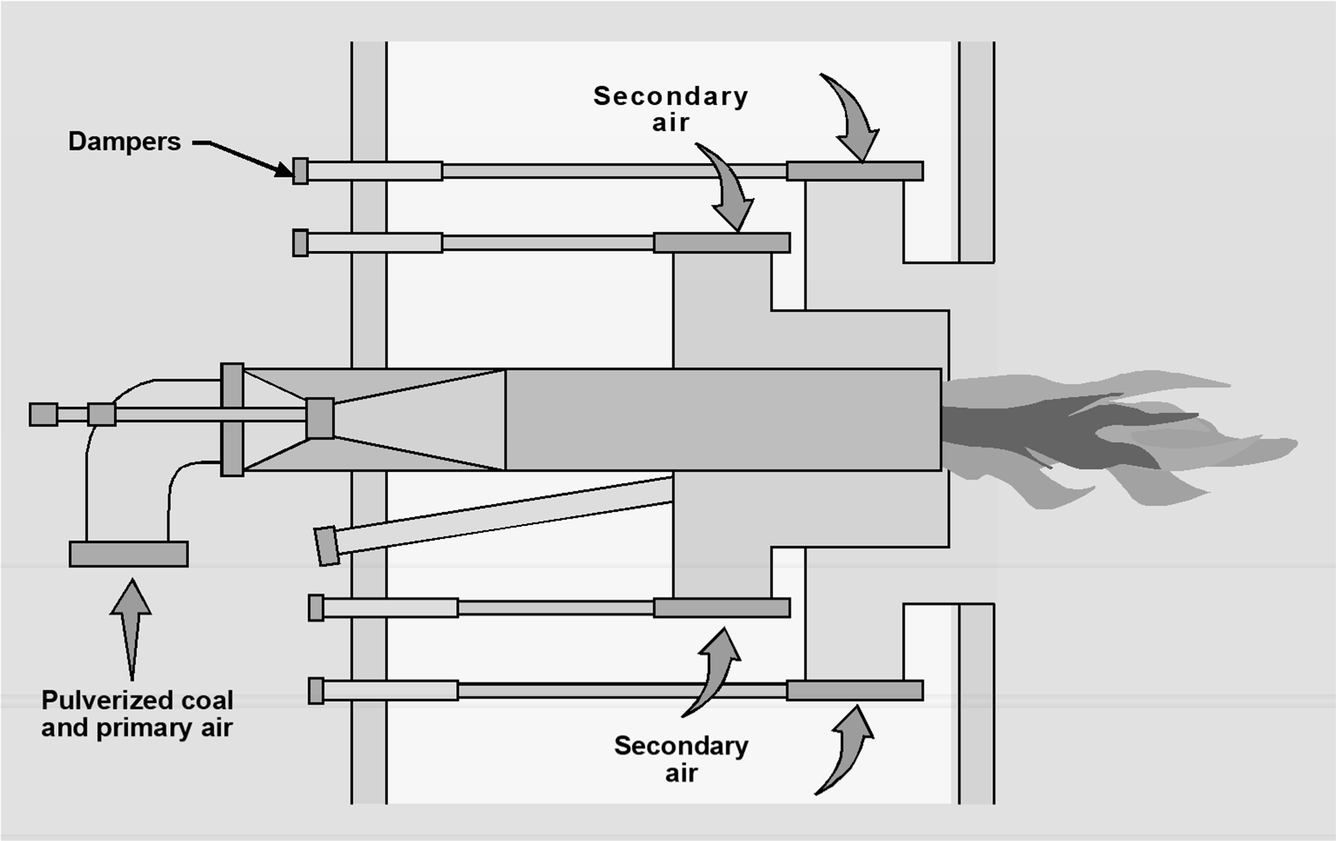
Dual Register Burner

Slide 97
NO_{x} Reduction with Low NO_{x} Burners
Typically, 25-60%. Ultra Low NO_{x} Burners have efficiencies approaching 80% and outlet concentrations less than 10 ppmv

Slide 98
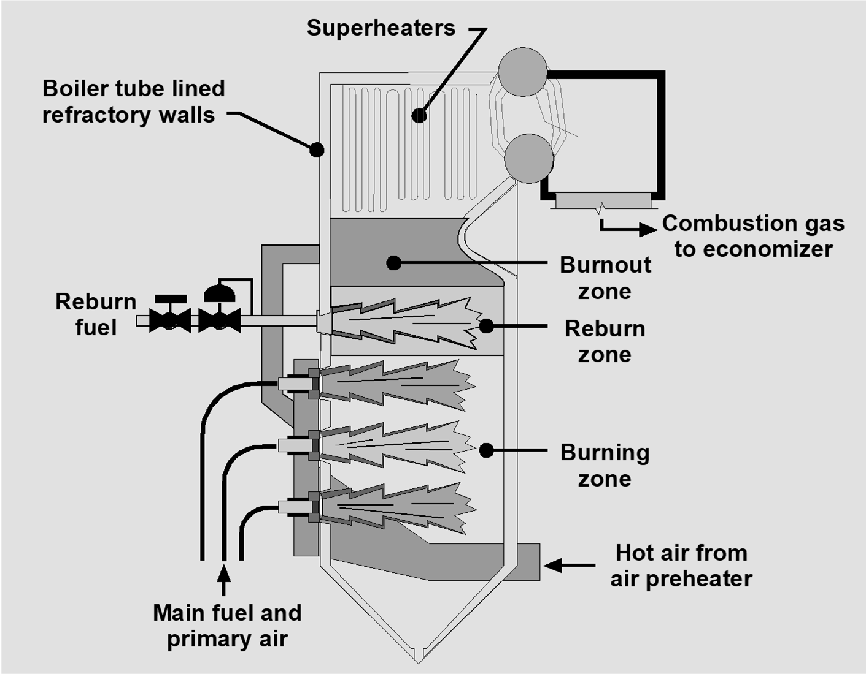
Gas Reburning

Slide 99
NO_{x} Reduction with Gas Reburning
Reductions of 50-70% have been demonstrated at full boiler load

Slide 100
Gas Turbine Combustion Modifications
Lean, pre-mixed combustors
Rich/quench/lean combustors
Water or steam injection

Slide 101
Fuel Switching
Coal nitrogen content
Fuel substitution
Gas co-firing

Slide 102
Flue Gas Treatment
Selective non-catalytic reduction (SNCR)
Selective catalytic reduction (SCR)

Slide 103
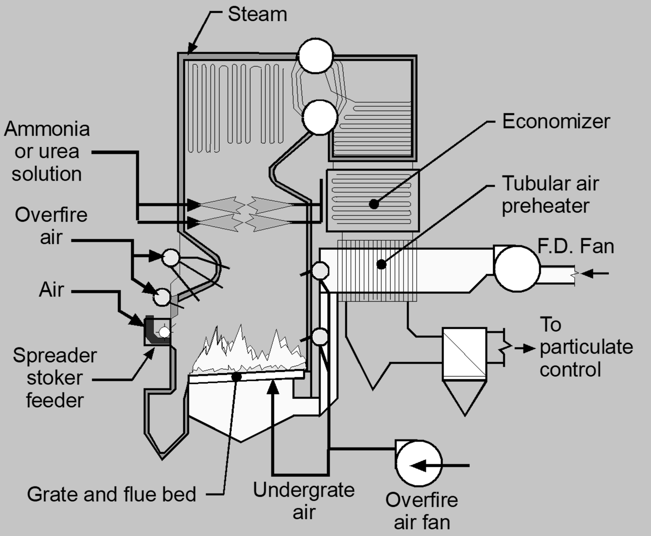
Selective Non-Catalytic Reduction

Slide 104
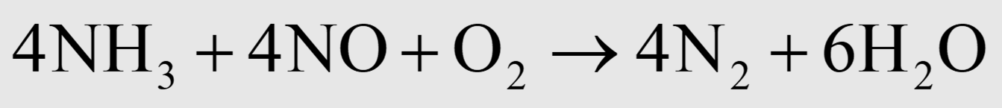
SNCR Reactions

Slide 105
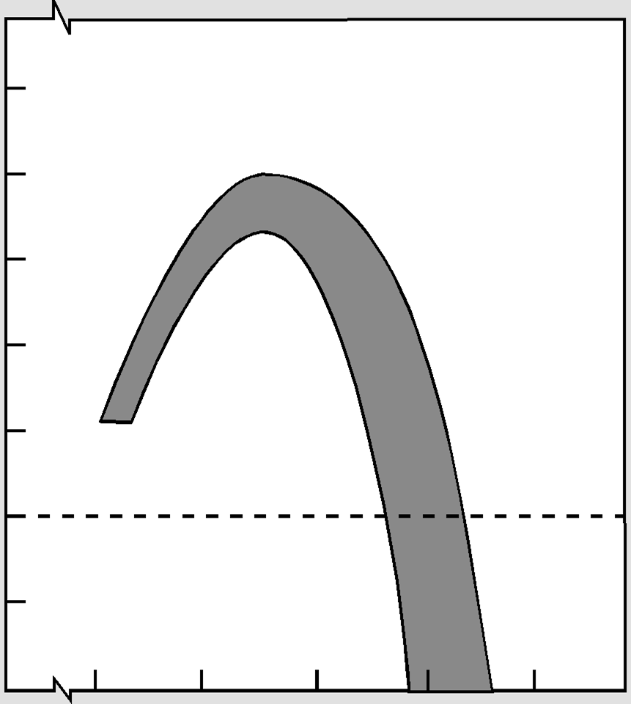
100
80
_{z}N
-
0
60
-
c:
0
(J
40
::::J
"C
Cl)
0:::
><
0_{z}
0
20
0
-20
-40
1400
1800
Gas Temperature, Degrees Fahrenheit
2200

Slide 106
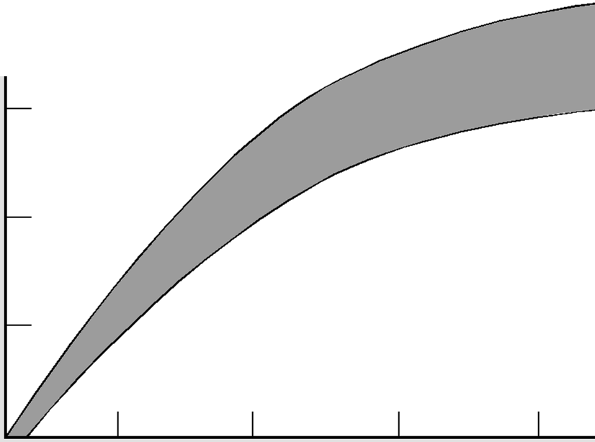
100
Note:
Efficiencies are as shown only when injection occurs in proper
_{z}N
.....
c
80
temperature range.
0
.....
60
(.)
:::::s
'tl
Q)
D::
><
40
0
z
20
0
0.2 0.4 0.6 0.8 1.0 1.2
Urea I NOx Molar Ratios
0.4 0.8 1.2 1.6 2.0 2.4
NH3 I NOx Molar Ratios

Slide 107
NO_{x} Reduction with SNCR
Typical reduction efficiencies for SNCR systems are 20-60%

Slide 108
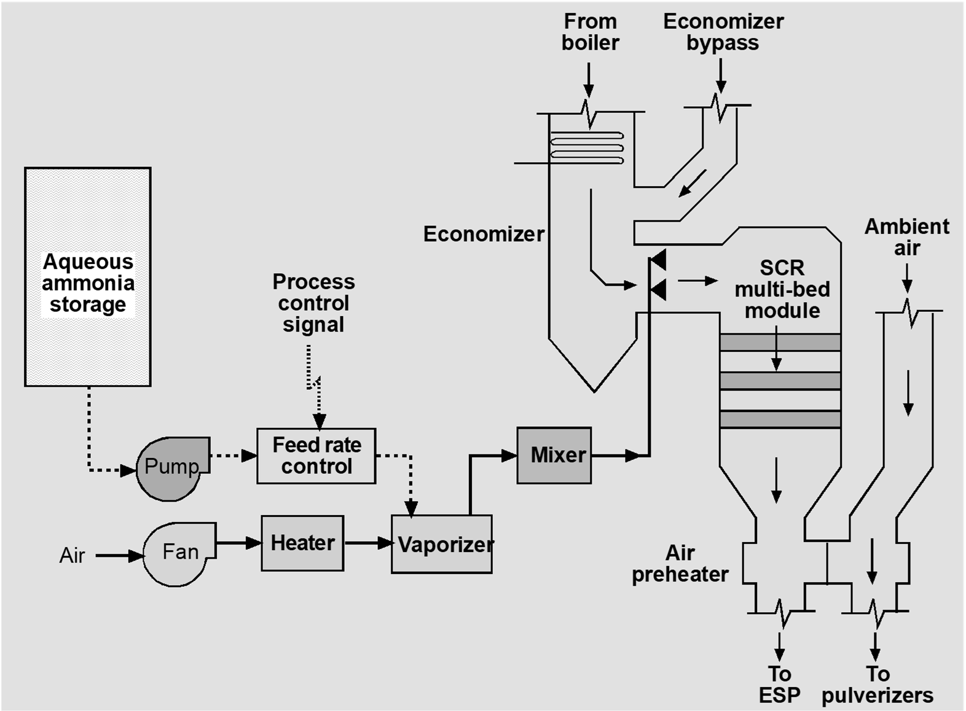
Selective Catalytic Reduction

Slide 109
SCR Reactions
Temperature range: 550-750°F

Slide 110


c
80
0
:.;:::;
(.)
::::s
'"O
Q)
et::
60
><
0
:z
0
40
0.8
0.9
1.0
1.1
1.2

Slide 111
Catalyst Materials
Noble metals (e.g., platinum, palladium, rhodium)
Vanadium pentoxide
Titanium dioxide
Tungsten trioxide

Slide 112

Sulfur Dioxide Oxidation

Slide 113


Formation of Sulfate Compounds

Slide 114
Common Catalyst Problems
Poisoning
Fouling
Masking
Sintering
Erosion

Slide 115
NO_{x} Reduction with SCR
Typical reduction efficiencies for SCR systems are 60-90%
Some gas turbines have outlet concentrations less than 4 ppm corrected to 15% oxygen

Slide 116
Control Technique | Typical Applications | NO_{x} Reduction Efficiencies, %
Combustion Modifications
Low Excess Air | Coal-Fired Boilers, Municipal Waste Incinerators | 15-30%
Staged Combustion | Coal-, Oil-, and Gas-Fired Boilers | 30-40%. 15-50%
Flue Gas Recirculation | Coal-, Oil- and Gas-Fired Boilers | 15-50%
Low NOx Burners | Coal-, Oil-, and Gas-Fired Boilers | 25-60%
Gas Rebuming | Coal-, Oil-, and Gas-Fired Boilers | 30-70%
Lean Combustors | Gas-Fired Turbines | > 90%
Water/Steam Injection | Gas-Fired Turbines | 60-75%
Flue Gas Treatment
SNCR | Coal-Fired Boilers, Municipal Waste Incinerators | 20-60 %
SCR | Coal-Fired Boilers, Gas Turbines | 80-90%
Fuel Switching
Low Nitrogen Coal | Coal-Fired Boilers Coal-Fired Boilers | No Data
Co-Firing | Coal-Fired Boilers | No Data

Slide 117
Instrumentation
Reagent feed rates and injection conditions
Gas temperatures
Static pressure drop
Gas turbine steam or water flow rates

Slide 118
Chapter 9
Control of Sulfur Oxides

Slide 119
Sulfur Oxides Formation Mechanisms
S + O₂ → SO₂ S + 1.5 O₂ → SO₃
SO₃ + H₂O → H₂SO₄

Slide 120






Economizer
Air Coal
(100 units
of sulfur)
Burn
Air preheater
Flue gas so₂ (94 to 95 units of sulfur)
Flue gas H₂so₄ (0.5 to 2 units
of sulfur)
Boiler ash
Air preheater ash
Bottom ash (3 to 5.5 units of sulfur)

Slide 121
SO_{x} Control Systems
Flue gas desulfurization
Fuel treatment
Low sulfur fuel firing

Slide 122

Flue Gas Desulfurization (FGD)

Slide 123

Wet FGD Systems

Slide 124
Non-Regenerative FGD Systems
Wet Systems:
Limestone | 50%
Lime | 20%
Dual-Alkali | 3%
Dry Systems:
Lime Spray Dryer
8%

Slide 125
Regenerative FGD Systems
Wet Systems:
Limestone Wellman-Lord
4%
3%

Slide 126
Limestone Scrubbing
SO₂ + CaCO₃ → CaSO₃ + CO₂ CaSO₃ + 0.5O₂ → CaSO₄

Slide 127






Clean flue gas
Mist eliminator
., --I...-..- wash water
Inlet flue gas
Lime/ --­ limestone
slurry
Makeup water
Solids to ill(
disposal
Thickener overflow tank

Slide 128
Lime Scrubbing
SO₂ + Ca(OH)₂ → CaSO₃ + H₂O CaSO₃ + 0.5O₂ → CaSO₄

Slide 129


Reagent Preparation

Slide 130


Slide 131
Dual Alkali Scrubbing
Absorption Reactions:
SO₂ + Na₂SO₃ + H₂O→ 2NaHSO₃ NaHSO₃ + 0.5O₂ → NaHSO₄

Slide 132
Dual Alkali Scrubbing
Regeneration Reactions:
2NaHSO₃ +Ca(OH)₂ → Na₂SO₃ + CaSO₃ + 2H₂O NaHSO₄ +Ca(OH)₂ → NaOH + CaSO₃ + H₂O

Slide 133




Clean flue gas
Demister
Inlet flue gas
Absorption loop
- Recirculation -
Liquid regeneration
Lime
tank
loop
Lime addition tank
Clarifier
Underflow
Rotary
Vacuum Filter
Filtered solids to landfill

Slide 134
Wellman-Lord Process
Absorption Reaction:
SO₂ + Na₂SO₃ + H₂O→ 2NaHSO₃
Regeneration Reaction:
2NaHSO₃ → Na₂SO₃ + H₂O + SO₂

Slide 135

Spray Dryer Dry Scrubbing

Slide 136
Types of Atomizers
Rotary atomizers
Compressed air assisted nozzles

Slide 137
Acid Gas Removal Reactions
SO₂ + Ca(OH)₂ → CaSO₃ + H₂O 2HCl + Ca(OH)₂ → CaCl₂ + 2H₂O

Slide 138

100
T approach to saturation 18°F
(.)
c
(])
(.)
&::::
(])
90
22°F
C'O
80
E
(])
L..
₀N 70
en
0.5
1.0
1.5
2.0
Alkalinity ratio

Slide 139

Dry Injection Dry Scrubbing

Slide 140
Fluidized Bed Combustion

Slide 141
Fuel Treatment
Coal gasification
Coal liquefaction
Coal cleaning
Physical methods
Chemical methods

Slide 142
SO_{x} Control Systems
Flue gas desulfurization
Fuel treatment
Low sulfur fuel firing

Slide 143
Instrumentation
Flue gas oxygen concentration
Static pressure drop
pH
Alkali feed rates
Inlet and outlet gas temperatures

Slide 144
Chapter 10
Control of Greenhouse Gas Emissions

Slide 145
The Greenhouse Effect
Wien’s Law
Α_{max} T = 2,897 μm-K
Sun @ 6,000 K: Α_{max} = 0.5 μm Earth @ 255 K: Α_{max} = 11.4 μm

Slide 146
Greenhouse Gases (GHG)
Carbon Dioxide (CO₂)
Methane (CH₄)
Nitrous Oxide (N₂O)
Fluorinated Gases

Slide 147





Radiation Transmitted by the Atmosphere
0.2
1 10
70
c Downgoing Solar Radiation
V'I 70-75% Transmitted
c
Q)
Upgoing Thermal Radiation 15-30% Transmitted
+-'
c
ro
i....
+_{u}-'
Q)
a.
V1
100-+-+---'-_, ._.......................
.......----r-.rL-.,............_.....,..,.......,..._,_......,.................
.........,mn-r-t --
--..._.._,...
1= 75
50
Q)
0... 25
Q)
Total Absorption
and Scattering
o+- ..-----
Ll!........!6
-.-----i.-.---..-.-.,::!!..::..._-.-
..--.--.---J..
 | Water Vapor Carbon Dioxide Oxygen and Ozone
Methane
Nitrous Oxide Rayleigh Scattering
V'I
+-'
c
Q)
c
0
a.
E
0
u
i....
0
0.2
1
10
70
Wavelength (µm)

Slide 148
Global Warming Potential
Gas | Atmospheric Lifetime (Years) | 100-Year GWP
Carbon Dioxide | 50-200 | 1
Methane | 12±3 | 28-36
Nitrous oxide | 120 | 265-298
Fluorinated gases as a group | 1.5-209 | 124-22,800

Slide 149


U.S. Environmental Protection Agency (2017}.Inventory of U.S. Greenhouse Gas Emissions and Sinks: 1990-2015.

Slide 150

Global Greenhouse Gas Emissions by Gas
F-gases 2%

Slide 151

2015_,U.S._Carbon Dioxide_Emissions, BY. Source
Other (Non-Fossil Fuel Combustion) 7%
Residential &
Commercial
10%
U.S. EnvironmentalProtection Agency (2017). Inventory of U.S. Greenhouse Gas Emissions and Sinks: 1990-2015.

Slide 152

.-....J
0
0
0
(Million Metric Tons C0₂ Equivalent)
..
.U. 1 .O. "I
0
0
0
Carbon Dioxide Emissions
0
0
0
0
0
0
.^{w}.
0
0
0
..
0
0
0
..
0
0
0
0
1990
1991
1992
1993
1994
1995
1996
1997
1998
1999
2000
2001 1
2002
2003
2004
2005
2006
2007
2008
2009
2010
2011
2012
2013
2014
2015
G) c
ib j.11
lb m
0 -·
3· !_{a}!!..
§ o'
Q. :J
l.l) "'
0
.Q,
!-tl
ni .....
ii: a
l.l) 0
0 ......
::r <
G) 3
Q fl)
(/) :J
a· n>
!..'.?... _
_{"s}' _{'-}-:......J.
:::> :J
lb :J
:::>' fl)
,,.... :J
Vi :::>
f;; a
':!>
.

Slide 153

Metba ne-Em1issions, BM Sou1r:ce
2015 U.S.
1
Manure Management 10%
U.S. Environmental Protection Agency {2017). Inventory of U.S. Greenhouse Gas Emissions and Sinks: 1990-2015.

Slide 154
8
Methane Emissions
(Million Metric Tons C0₂ Equivalent)
8
8
m
8 8
8
W
8
N
8 8
1990
1991
1992
1993
1994
1995
1996
1997
1998
1999
2000
2001
2002
2003
2004
2005
2006
2007
2008
2009
2010
2011
2012
2013
2014
2015
c
•
m
s.
- 0
o·
.... -
0
-
3
"-'·"..t.i
a a
Vl )>
. ""'
c
I.I'
...
Ill
::i Ill
,... _
Ill
::i
<
::i
g
"_{m}'₋::i
Q. ::i
_ .OQ
::i
0 ....
o ·
V'I :<:i
Cl
Ill
::i
⁰c:
l6
Cl
QI
3
.... _
:8
-
0
;
.
.

Slide 155

2015 1u.s.Nitr:ous Oxide Emissions, B Sou1r:ce
1
Manure Management 5%
Transportation
Other
2%
5%
"""'
Industry or Chemical Production 6%
Stationary Combustion 7%
U.S.Environmental Protection Agency (2017).Inventory of U.S. Greenhouse Gas Emissions and Sinks: 1990-2015.

Slide 156

0
Nitrous Oxide Emissions (Million Metric Tons C0₂ Equivalent)
0
0
W 0
W
0
0
N
0
N
0
0 0
0
0 0
1990
1991
1992
1993
1994
1995
1996
1997
1998
1999
2000
2001
2002
2003
2004
2005
2006
2007
2008
2009
2010
2011
2012
2013
2014
2015
(I) V>
(I) •
⁰c: ^{s}......
m -
Cl! (")
Q) O'.
\0 N
\0 0
.... -
-
V> l>
:::l ^{C}(⁷I^{Q})
;ti:' :::l
0 ....
c
(n
:::i m
:::l
Cl! 0
(I) :::l
Ci) 3
Q) (I)
Cl! :::l
3
C⁻l!· ".....
!!?. 0
a. :::l
' .....
V.1 :<::l
:::l
₀:::l (I)
:::l 0
·
(I)
0
^{C}...^{i}..^{)c}.
<
.... _
_{o}N
-
0

Slide 157

Electrical Transmission and
Distribution 2%
Production and Processing of Aluminum and
HCFC-22
Production 2%
Semiconductor Manufacture 3%
U.S. Environmental Protection Agency (2017). Inventory of U.S. Greenhouse Gas Emissions and Sinks: 1990-2015.

Slide 158



N
0
0
00
0
Fluorinated Gas Emissions (Million Metric Tons C0₂ Equivalent)
m
0
N +::-
0 0
o
0
oo
0
+;:. m
0
0
N
0
1990
1991
1992
1993
1994
1995
1996
1997
1998
1999
2000
2001
2002
2003
2004
2005
2006
2007
2008
2009
2010
2011
2012
2013
2014
2015
::I m
s.
V> 0
::I
(;) 3
Q)
V> ::I m ,...
3
(")
.
IQ N
-
0 ....
::I
c.. ::I
(/) )>
IQ 0
0 ....
:..:.^{I}.
c
(·/)
':1" ::I
.... _
....,
<
';It:" ::I
V'I ::I
(..;.)c.
c⁰: ...
⁻V>^{·-}..⁰.
!!:!. 0
::I 0
-_{::I}·O'Q
..., _
º....-·
. <
⁰...
0
V>
Q)
!'?
'
,

Slide 159


Commercial & Residential
12%
U.S.Environmental Protection Agency {2017). Inventory of U.S. Greenhouse Gas Emissions and Sinks: 1990-2015

Slide 160

GHG Emissions by Industrial Sector

Slide 161


Figure 1-2: Total 2002 U.S. Greenhouse Gas Emissions from Industrial Sources,by Sector (MMTC02E), Factorin in Purchased Electricity
Cement
4 %
Oil and Gas
24 %
I
Alumna and Aluninum
3%
Other Industrial Sectors
16%
2%
Metal Casting
1%
/ '
Total:

Slide 162
GHG Emissions from Industrial Sources
EPA produced “white papers” that focus on the industrial sectors that emit the highest amounts of GHGs:
Coal Fired Electric Generating Units (EGUs)
Large Industrial/Commercial/Institutional Boilers
Pulp and Paper
Cement
Iron and Steel Industry
Refineries
Nitric Acid Plants
These paper are located at: http://www.epa.gov/nsr/ghgpermitting.html

Slide 163
,oo
8
0
Total GHG Emissions
( Million Metric Tons of C0₂ Equivalents)
......i
"
8
0
8
..°. '
0
,V'I
8
0
...
8
0
w
"
8
0
N
"
8
0
8
0
"
0
1990
1991
1992
1993
1994
1995
1996
1997
1998
1999
2000
2001
2002
2003
2004
2005
2006
2007
2008
2009
2010
2011
2012
2013
2014
2015
s.
0 ...
..... -
-
Ci) 3
:,.:.^{l}.
Q) •
Vl l>
IO 0
0 .....
.....,
o·
...
c
!n
rt> Vl
::i m
:::r ::l
rt> ::l
II> a
c.. ::l
'11'" ::l
IO N
(..n :<:l
II> 0
!!?. 0
::l 0
..... _
0
Ci)c.
rt> •
Q) rt>
::l rt>
⁻::l^{·C}r¹t^{Q}>
,.., _
rt>
::l
-<
I_{m}I>
³-·
0
⁰c:
II>
!'?

Slide 164

Global Carbon Emissions from Fossil Fuels, 1900-2014
11,000
10,000
9,000
c
0
.0
'-
_{u}tO
8,000
7,000
Cl\
c
6,000
.....
-
·-
5,000
4,000
'-
Q>
c
·-
3,000
·-
2,000
1,000
0
1900 1910
1920
1930
1940
1950
1960
1970
1980
1990
2000
2010

Slide 165

2014 Global
 | 1(0 | 2
Emissions firom EossU F.uel
Japan 4%
Russian Federation 5%

Slide 166
00
0
0
0
.......
0
0
0
GHG emissions (million tonnes C02 equivalent)
O')
0
0
0
•0
N -"
0 CJ)
0 CJ)
00 0
<.n
0
0
0
0
0
0
0""
0
0
N
0
0
0
.....
0
0
0
0
t
Japan Germany Canada
UK
Australia
Italy France
Ukraine Spain
Poland
Turkey Netherlands Romania Czech Rep.
Belgium Greece Belarus Austria Portugal
New Zealand
Bulgaria
Hungary Finland Ireland
China • •
United States
Russia India •
Denmark SWeden Norway
Switzerland

Slide 167

406.53 ppm
Late t CO reading
2
October 25, 2018
Carbon dioxide concentration at Mauna Loa Observatory
410
400
390
380
370
360
350
340
330
320
Full Record ending October 27, 2018
.-.
E
Q.
.^{Q}_..
c
·.-..
.^{c}.^{u}.
c
Q)
C_{c}J
0
(.)
0
(.)
N
SCRIPPS 10111•t1....
OCEANOGRAPHY --
2010 2015
1960
1965
1970
1975
1980
1985
1990
1995
2000
2005

Slide 168

Global Temperatures

Slide 169
Regulation of GHG
April 2, 2007: U.S. Supreme Court held that EPA has authority to regulate CO₂ & other GHGs from new motor vehicles
Even though GHGs are “air pollution”, EPA still needed further findings to regulate them under CAA Title I (stationary sources) or Title II (mobile).
December 17, 2009: EPA Administrator found that current and projected GHG concentrations endanger the public health and welfare of current and future generations (the “endangerment finding”)

Slide 170
GHG Reporting Program
October 30, 2009: EPA issued 40 CFR Part 98, which requires reporting of greenhouse gas (GHG) emissions
Suppliers of fossil fuels or industrial GHGs, manufacturers of vehicles and engines, and facilities that emit ≥ 25,000 metric tons per year of GHG emissions are required to submit annual reports to EPA. First reports were due September 30, 2011.

Slide 171
Mobile Source GHG Regulation
May 7, 2010: EPA passed the first ever CO₂ emission standards for light duty vehicles for years 2012 to 2016
Sept 15, 2011: GHG emissions standards
& fuel efficiency standards for medium & heavy-duty vehicles for years 2017 to 2025
March 7, 2017: Notice of intent to reconsider standards for years 2022 to 2025

Slide 172
GHG Tailoring Rule
June 3, 2010: EPA sets thresholds for GHG emissions that define when permits under PSD & Title V Operating Permit programs are required
PSD: New:100,000 tpy of CO₂e ; Modified: 75,000 tpy of CO₂e
Title V: Existing or new sources with PTE ≥ 100,000 tpy of CO₂e

Slide 173
Revised NSPS for Oil and Gas Sector
August 2, 2016
Sets percent reduction and work-practice standards for reducing emissions of methane and VOCs from specific oil and gas sector operations

Slide 174
NSPS for New EGUs
October 23, 2015
New steam generating units
1,400 lb CO₂/MWh gross
Modified/reconstructed steam generating units
1,800 lb CO₂/MWh gross for larger units (> 2,000 mmBtu/hr)
2,000 lb CO₂/MWh gross for smaller units (≤ 2,000 mmBtu/hr)
New/reconstructed stationary turbines
1,000 lb CO₂/MWh gross for base load units
120 lb CO₂/MWh gross for non-base load units
120-160 lb CO₂/MWh gross for multi-fuel units

Slide 175
Clean Power Plan
December 22, 2015
Stayed by Supreme Course February 2016 Repeal Proposed October 10, 2017
Guidelines for states to follow in developing plans to control existing steam generating units and stationary turbines
Sets emission performance rates
1,305 lb CO₂/MWh for steam generating units
771 lb CO₂/MWh stationary turbines
Sets state-specific rate- and mass-based emission goals
By 2030, 32% emission reduction from 2005 expected

Slide 176
Affordable Clean Energy Rule
Proposed August 21, 2018
Defines BSER as on-site efficiency improvements
Provides states with a list of candidate technologies
Updates EPA’s New Source Review permitting program
Revises the implementing regulations

Slide 177
GHG Emission Reduction Strategy
Reduce energy use
Reduce the use of fossil fuels, particularly coal, in the production of energy

Slide 178
Reducing GHG Emissions
Alternative and renewal energy sources
Energy efficiency improvements
EPA’s Energy Star Program incentives
Energy Management Systems (EnMSs)
Benchmarking/Energy Performance Indicators (EPI)
Carbon Capture and Storage (CCS)

Slide 179
Alternative and Renewable Energy Sources
Alternative and Renewable Energy can:
Improve efficiency
Reduce GHG emissions
Solar, wind, geothermal, nuclear, and biomass technologies reduce GHG emissions from traditional combustion processes

Slide 180
EPA’s Energy Star Program
Used by hundreds of U.S. manufacturers
Assists with stronger energy management
Emphasizes continuous improvement of energy performance

Slide 181
Energy Management Systems (EnMSs)
Framework to manage energy
Facilitates improvement

Slide 182
Benchmarking/Energy Performance Indicators (EPI)
Benchmarking
Measures improvements in energy efficiency
Set and track progress toward goals based on individual performance, or the industry
Plant Energy Performance Indicators (EPI)
Part of the U.S. EPA ENERGY STAR Program
Benchmarking tools establish ‘best in class’ for specific industrial sectors.

Slide 183
Carbon Capture and Storage (CCS)
Separation of CO₂ from other gases
Transportation of CO₂ to storage location
Injection and long-term geologic storage

Slide 184
CO₂ Capture
Pre-combustion capture
Post-combustion capture
Oxy-combustion

Slide 185

Pre-Combustion Capture

Slide 186

Post-Combustion Capture

Slide 187
CO₂ Capture Media
Amine-based scrubbing systems
Monoethanolamine
Diethanolamine
Methyldiethanolamine
Diglycolamine
Mineral-based scrubbing systems
Sodium hydroxide
Lithium hydroxide
Solid sorbents (MOFs)
Membrane-based capture

Slide 188

Oxy-Combustion

Slide 189


Schematic diagram of possible CCS systems
-
Gas to domestic supply

Slide 190


co2 Stored in Saline Formation

